Slide 1
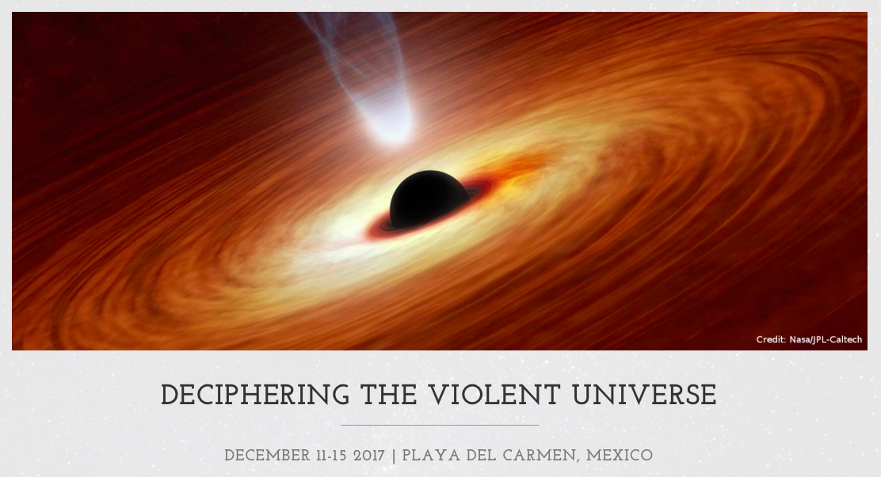
11 December 2017
Blazars in outburst:
A multi-messenger approach
Elena Pian
INAF, IASF Bologna, Italy

Slide 2
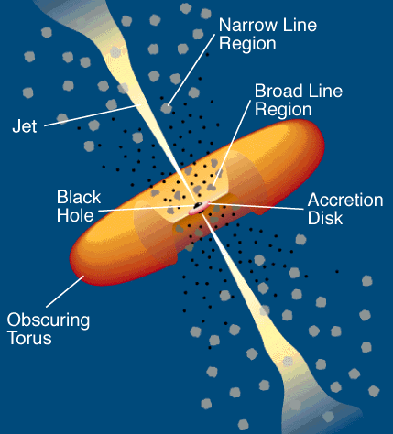
UNIFIED SCHEME OF AGN
(Urry & Padovani 1995)
~10% of all AGNs are
radio-loud, and a
small fraction of
these are blazars

Slide 3
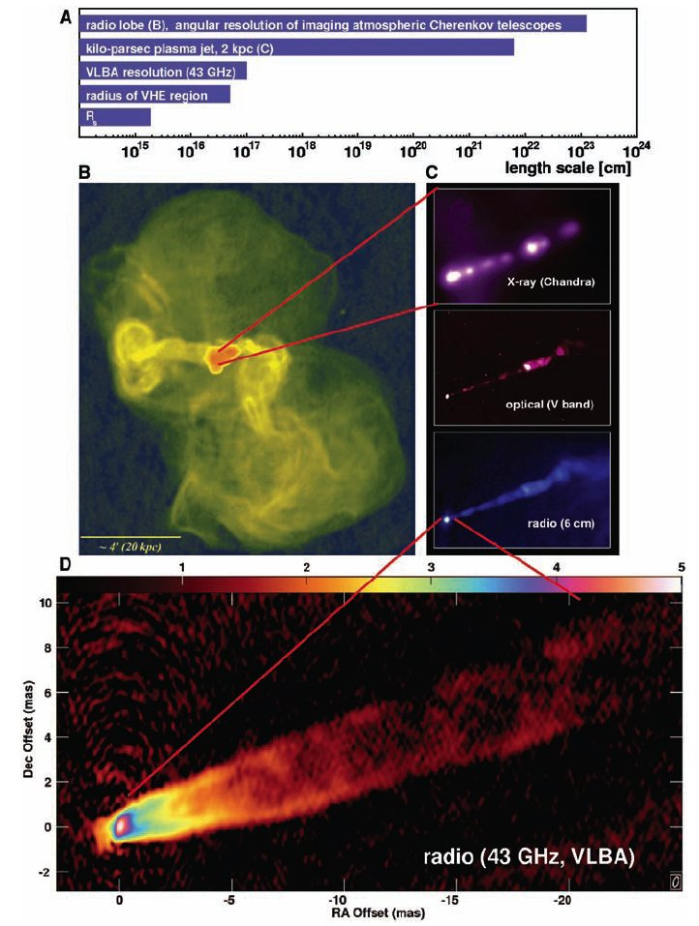
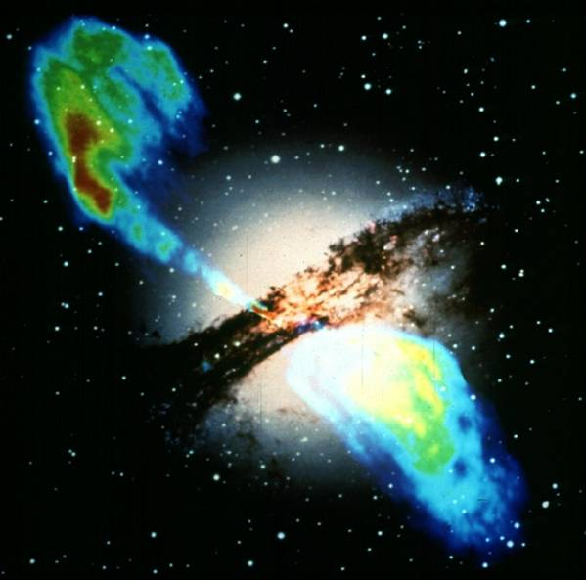
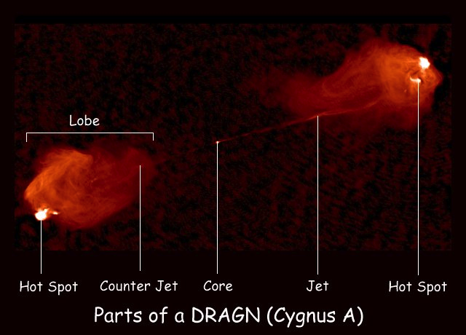
Extragalactic Jets: radiogalaxies and blazars
Lorentz factors Γ~ 10-20
Cen A
d = 4 Mpc
Virgo A (M87)
d = 20 Mpc
VLA
z = 0.056

Slide 4
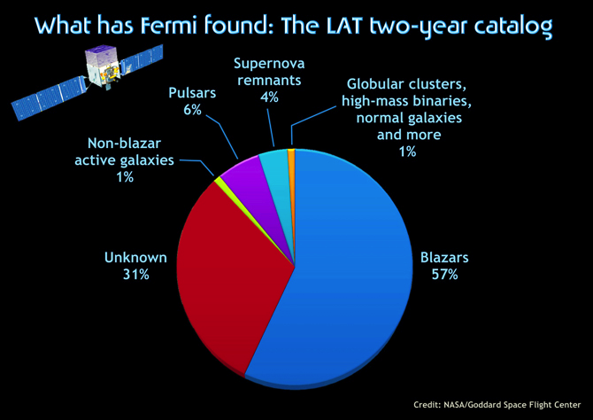
Second Fermi LAT Catalog (2FGL): 1873 sources
(~1000, compare with 66
CGRO-EGRET blazars!)
(576; 187 of these
already identified
as blazars thru
comparison with WISE
Catalog, Massaro et al. 2012)

Slide 5
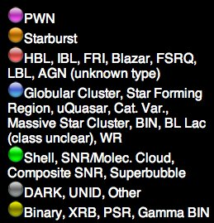
TeV Sky interactive
map
http://tevcat.uchicago.edu
(M82, NGC253)
~200 sources

Slide 6
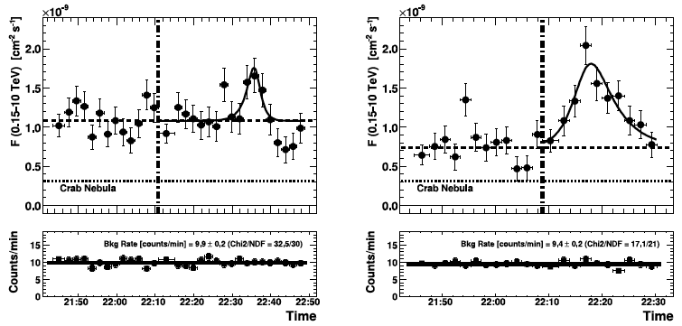
TeV minute time-scale variability of Mkn501 (MAGIC)
30 June 2005 9 July 2005
Albert et al. 2007

Slide 7
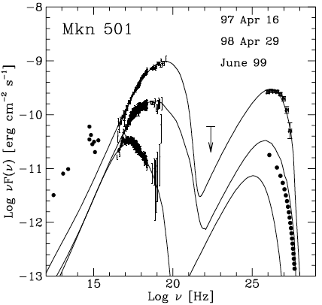
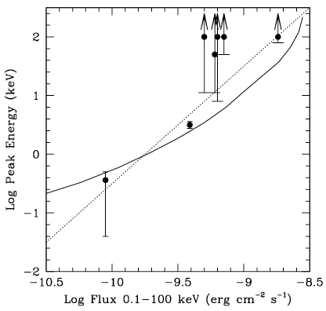
Synchrotron peak frequency vs X-ray power in extreme blazars: the prototype Mkn501 (z = 0.034)
16 Apr 97
29 Apr 98
Jun 99
Pian et al. 1998; Ghisellini 1999; Tavecchio et al. 2001

Slide 8
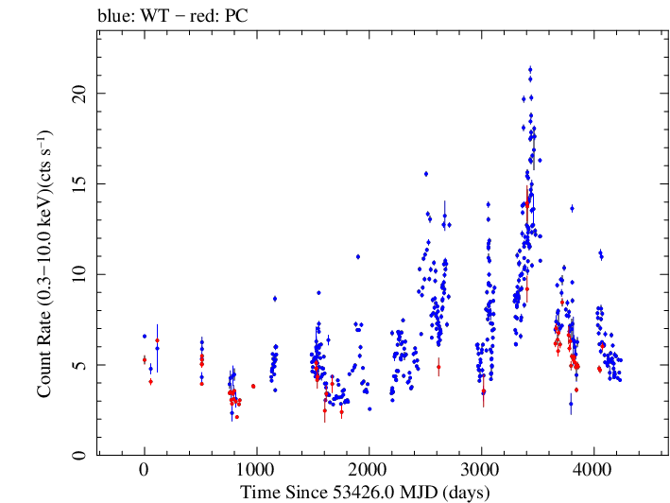
Mkn501 (z = 0.034): Swift XRT light curve
May 2014
Jul 2013

Slide 9
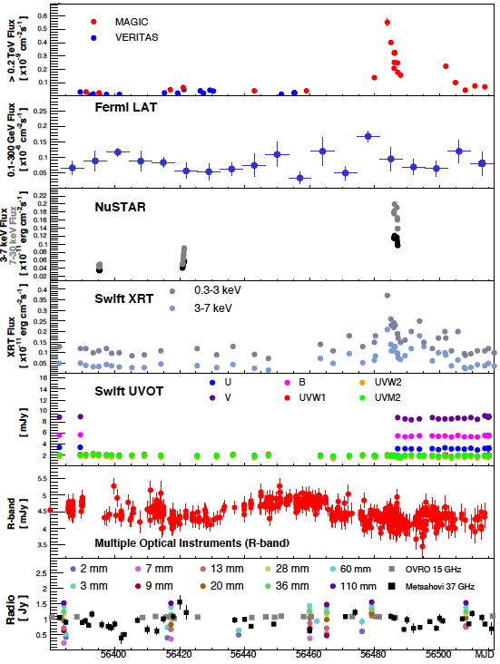
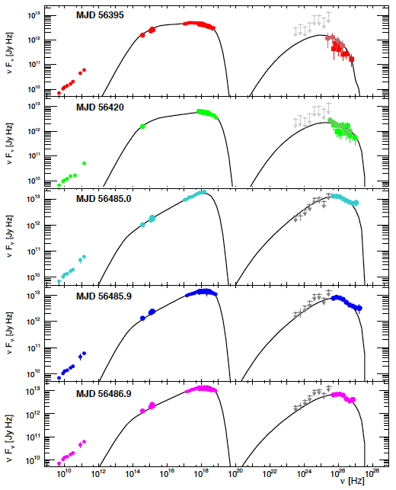
Nustar observations of Mkn501 in August 2013
Furniss et al. 2015

Slide 10
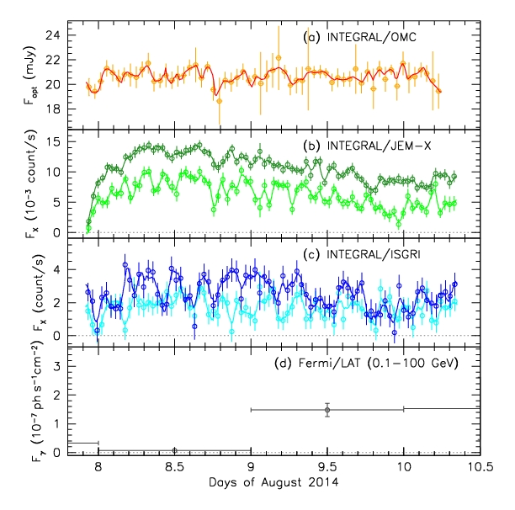
Mkn501: INTEGRAL observations in Aug 2014
Restart of instruments after perigee passage

Slide 11
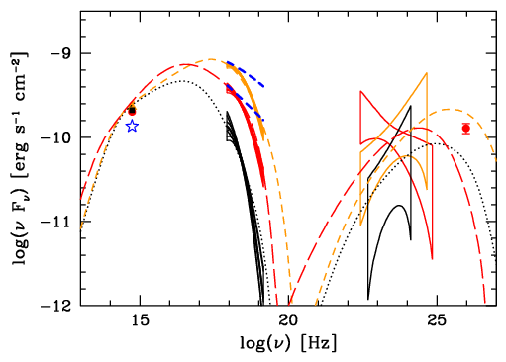
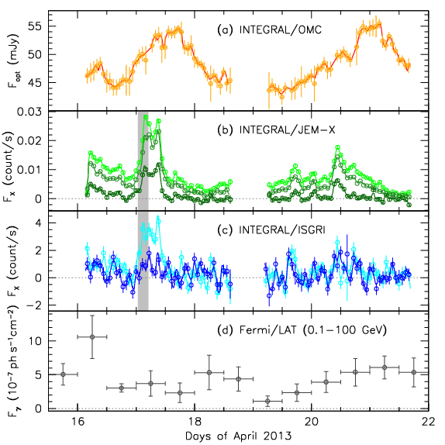
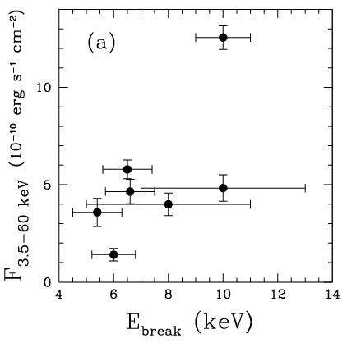
High
synchrotron
peak BL Lac
Mkn421
(z = 0.031)
INTEGRAL JEMX+IBIS
Fermi-LAT
INTEGRAL
OMC
Veritas
16 Apr 13
17 Apr 13
19 Apr 13
June 2006
April 2013
The peak energy correlates with the flux but has an upper limit of ~10 keV
Lichti et al. 2008; Pian et al. 2014

Slide 12
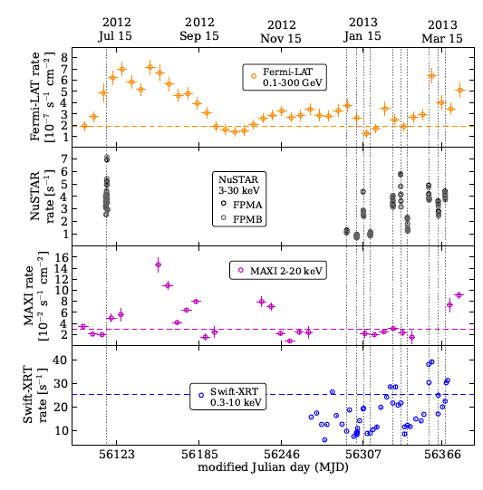
Mkn421
with
NUSTAR
Balokovic et al. 2016

Slide 13
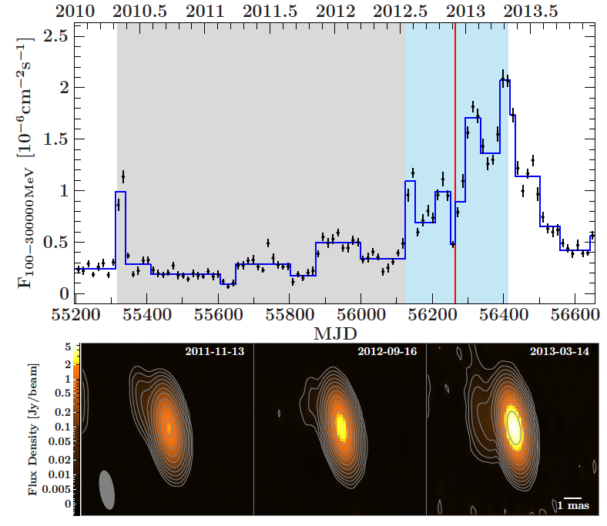
TANAMI project: blazar PKS1424-418 (z = 1.522) associated with “BigBird”, ICECUBE PeV neutrino of 2 Dec 2012
Fermi-LAT
A photo-hadronic mechanism is required to explain the neutrino emission
VLBI
1mas = 8.3 pc
Kadler et al. 2016

Slide 14
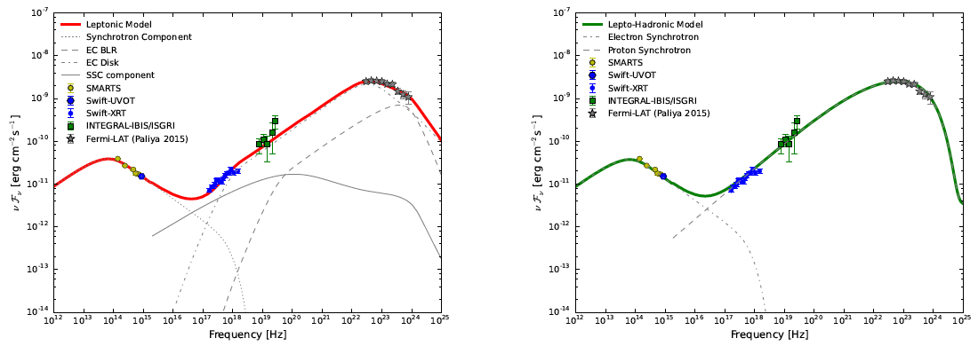
3C279 (z = 0.54): extremely bright outburst of June 2015, during INTEGRAL Coma survey (exposure on 3C279 was 50 ks)
Fully leptonic model
lepto-hadronic
Leptonic model cannot make TeV radiation (emitting region is 0.01 pc, well within BLR)
Lepto-hadronic model has stiff requirement on proton law (rather flat, index -1.8), and implies jet power of ~e48 erg/s
Bottacini, Boettcher, EP, Collmar 2016

Slide 15
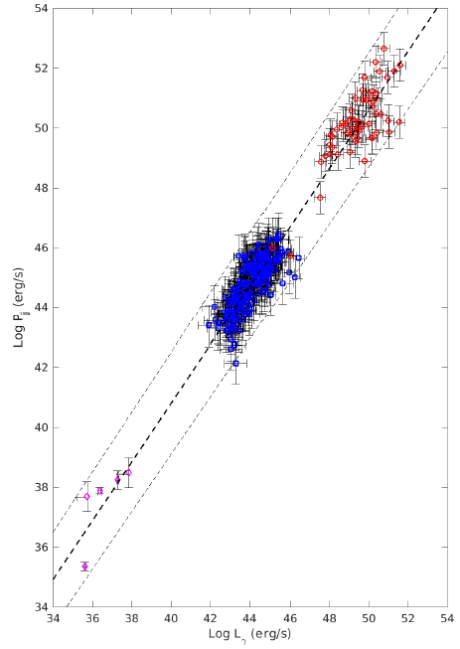
Pjet vs Ljet relationship in GRBs, blazars, X-ray binaries
GRBs
Radiation efficiency holds over many orders of magnitude in luminosity and jet power
Blazars
Pjet ~ Ljet
X-ray Binaries
Nemmen et al. 2012
Ma et al. 2014
Lamb, Kobayashi, EP 2017

Slide 16
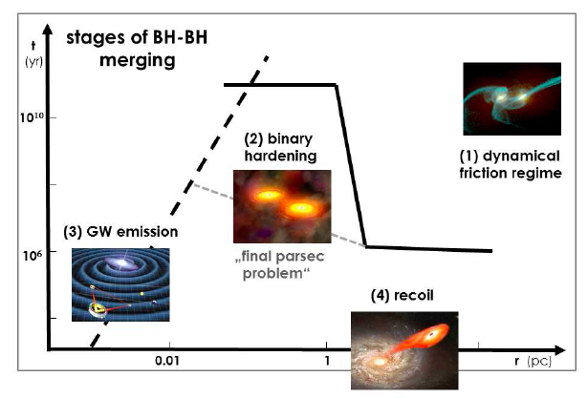
SMBH binary evolution, inspiral and merger
Komossa & Zensus 2015

Slide 17
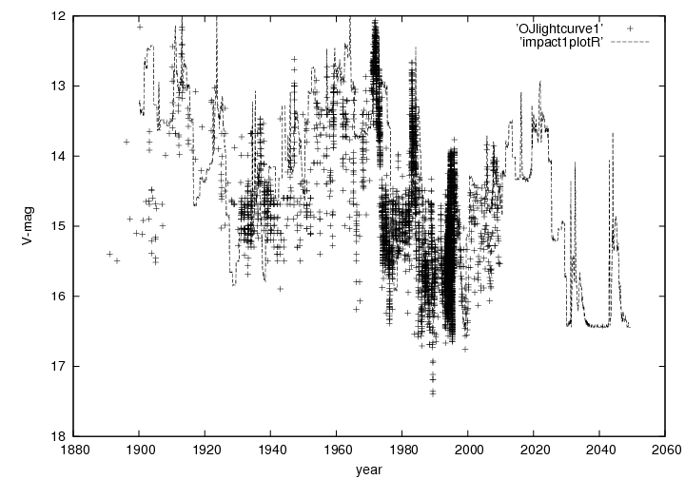
OJ 287 (z = 0.306): historical optical light curve
Rest-frame period: ~8 yr
Valtonen & Sillanpaa 2011

Slide 18
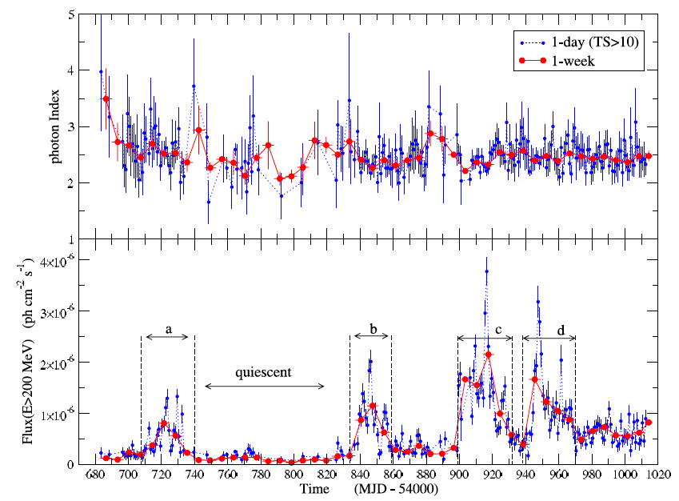
PKS1510-089 (z = 0.361)
Fermi-LAT (Sep 2008 – Jun 2009)
Abdo et al. 2010

Slide 19
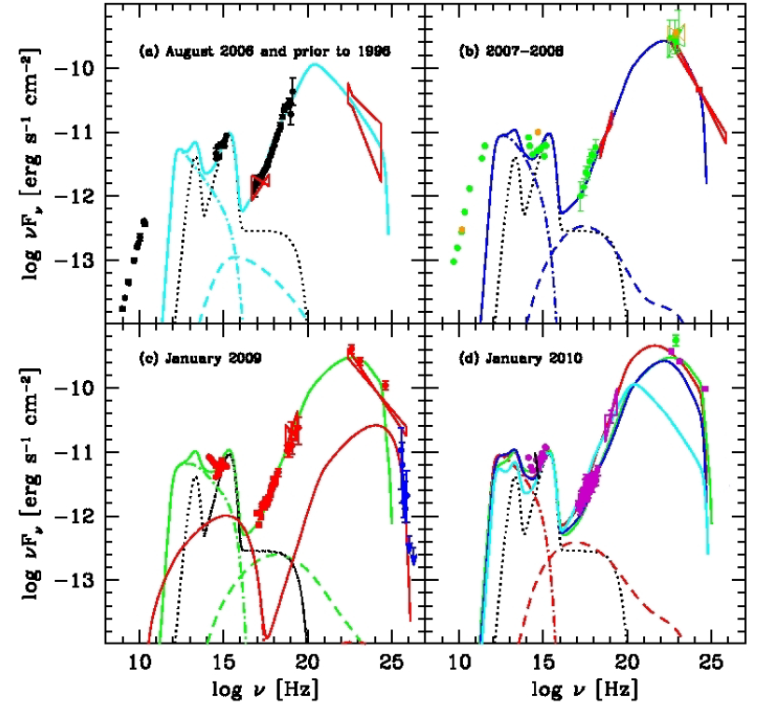
PKS1510-089 (z = 0.361): one of a handful of TeV FSRQs
2 emitting zones
Inner
outer
Castignani, EP, et al. 2017

Slide 20
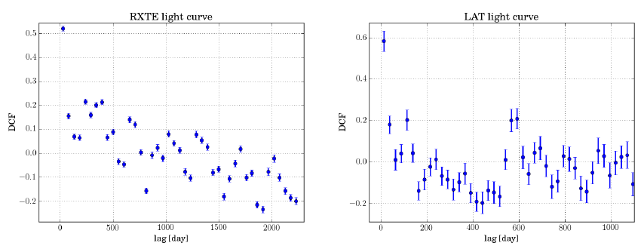
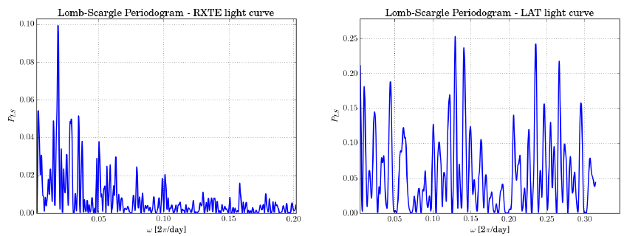
PKS1510-089 (z = 0.36): periodicity search returns negative results
Castignani, EP, et al. 2017

Slide 21
Conclusions
Variability has different characteristics even in the same source,
and depending on the source state: inhomogeneous regions and multi-component models (see e.g. TeV emission in FSRQs)
Ultra-high energy neutrinos may set critical constraints (see PKS1424-418,
Z = 1.522, and recent IceCube event 170922/TXS0506+056, z > 0.15)
Jet fundamental properties and mechanisms may be governed by few parameters and may be largely independent on central BH mass
Periodicity or recurrence is potentially an important parameter to understand the emission mechanisms and as tracers of nuclear mergers, but the significance is so far limited

