Slide 1
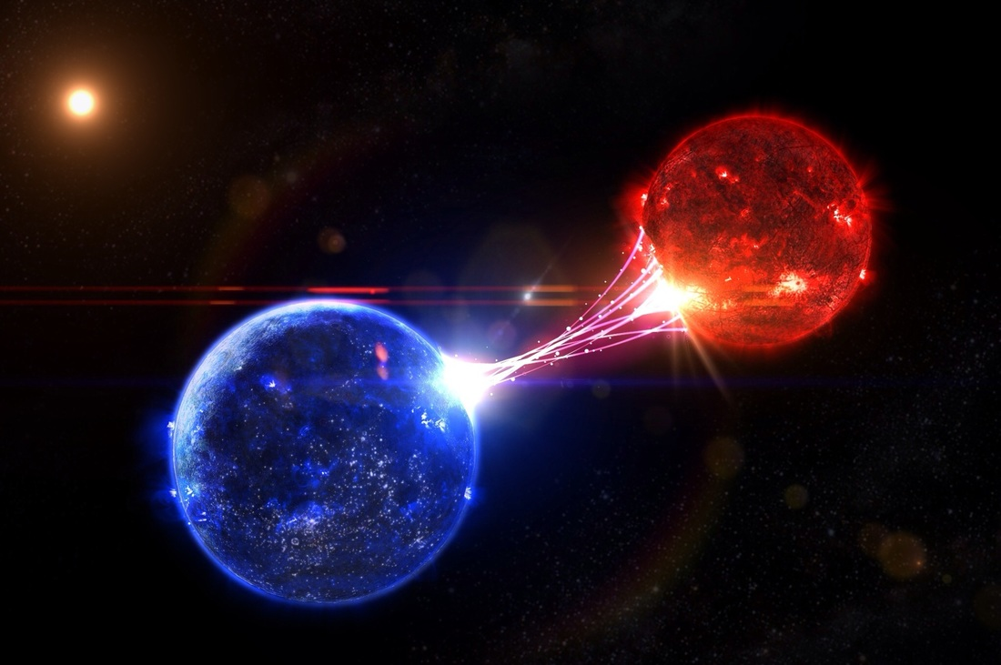
A HST Search for the Binary Secondaries of Nearby Stripped-Envelope Supernovae
Ori Fox
STScI
@fox_ori
DVU, Playa de Carmen, Mexico Dec. 12, 2017

Slide 2
A HST Search for the Binary Secondaries of Nearby Stripped-Envelope Supernovae
Ori Fox
STScI
@fox_ori
DVU, Playa de Carmen, Mexico Dec. 12, 2017

Slide 3
Single vs Binary
Single star models work, but no direct observational evidence for a progenitor
Binary star models work, but no direct observational evidence for a companion
Notes:
Can increase mass loss rate in lower mass stars.
If a higher mass star loses it’s outer envelope, it might appear more blue and luminous.

Slide 4
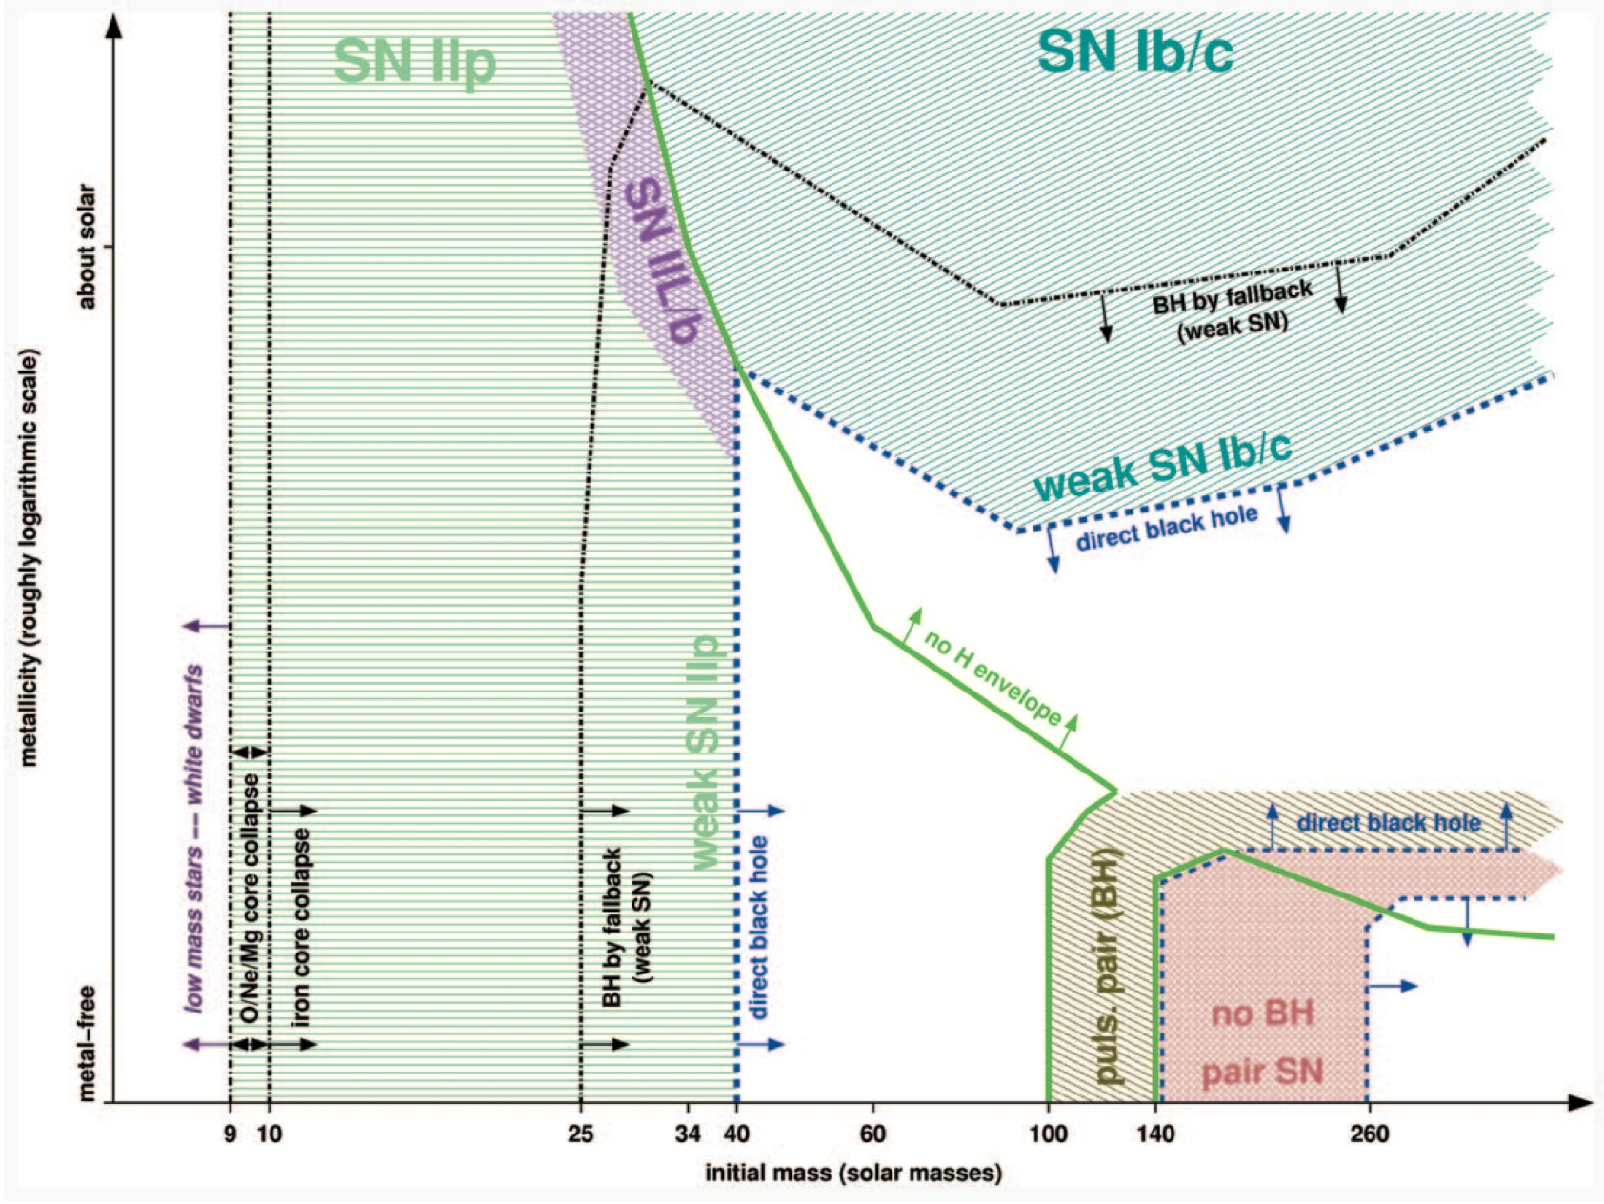
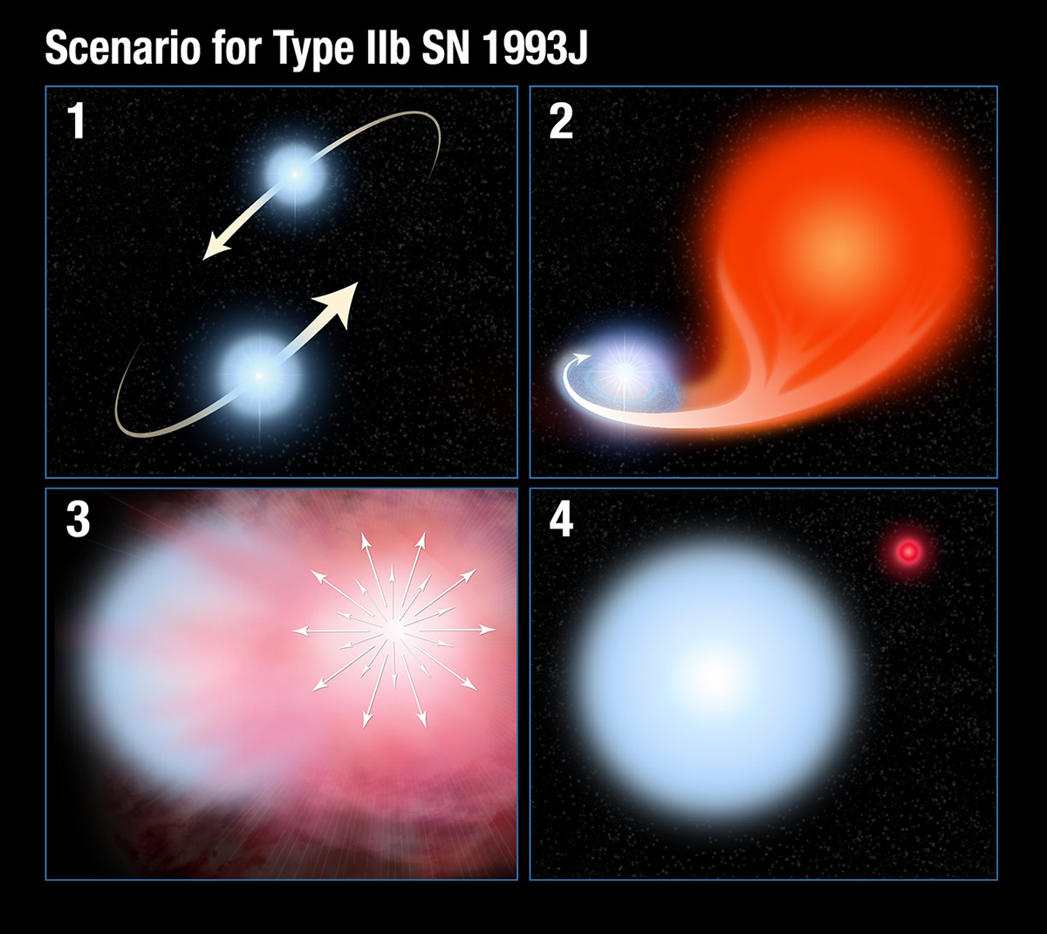
Single vs Binary
Single star models work, but no direct observational evidence for a progenitor
Binary star models work, but no direct observational evidence for a companion
Heger+03
ODF+14a, Press Release
Notes:
Can increase mass loss rate in lower mass stars.
If a higher mass star loses it’s outer envelope, it might appear more blue and luminous.

Slide 5
Type IIb SN 1993J Progenitor
Maund+04
Notes:
Can increase mass loss rate in lower mass stars.
If a higher mass star loses it’s outer envelope, it might appear more blue and luminous.

Slide 6
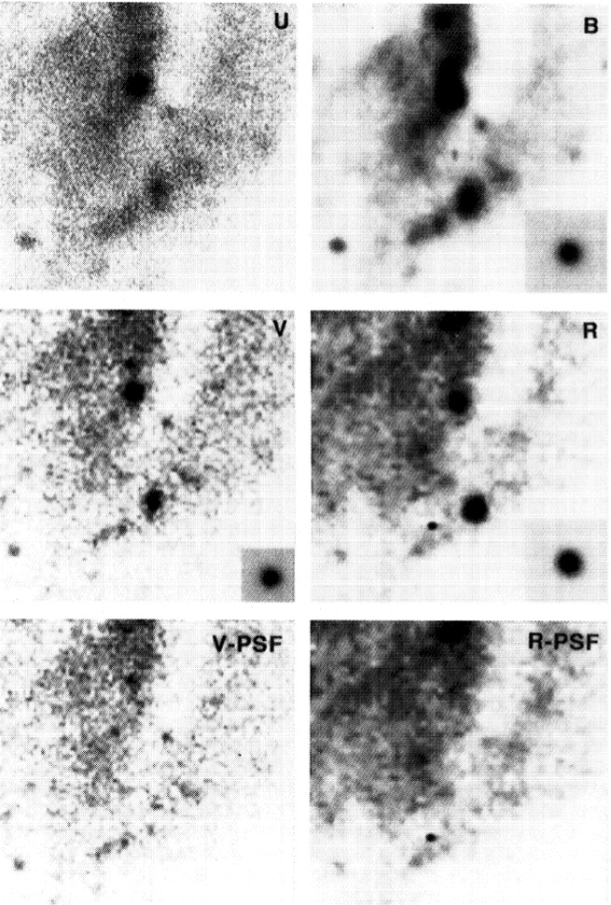
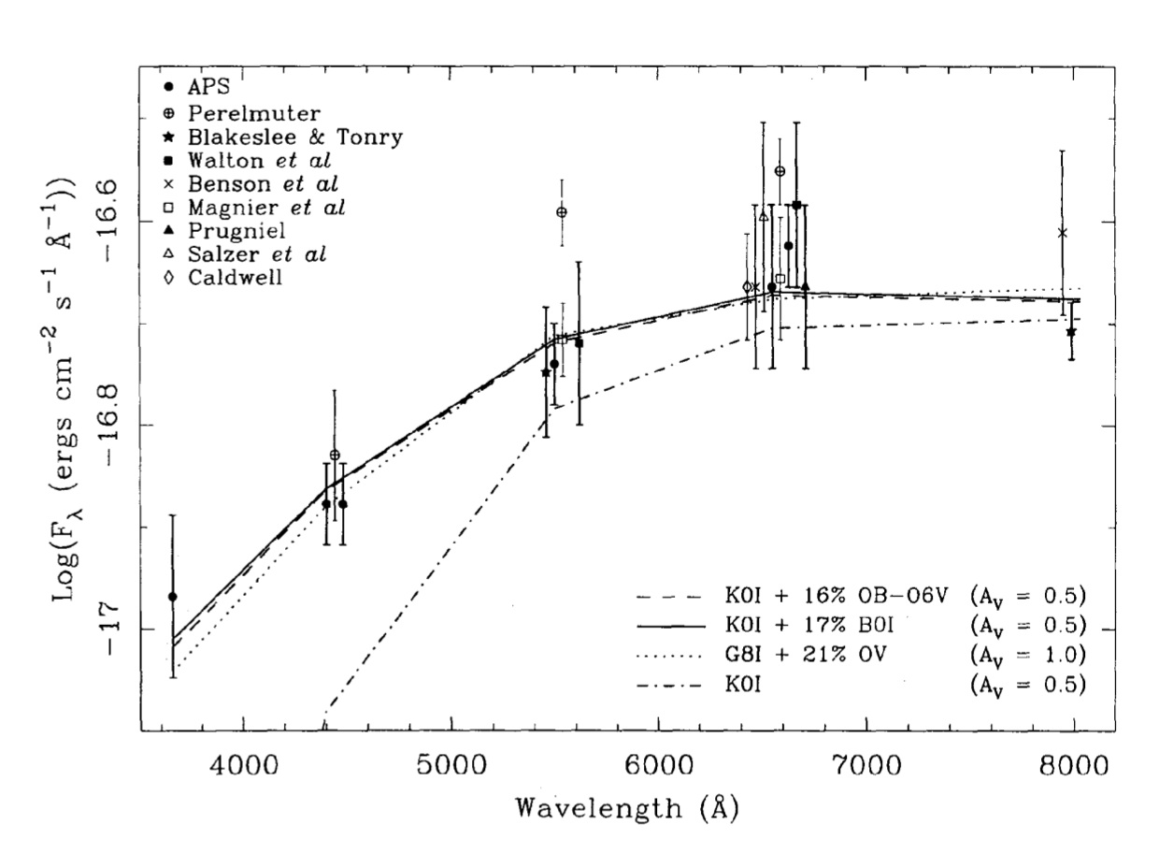
Type IIb SN 1993J
Red (K) Supergiant Primary
Aldering+94
Notes:
Can increase mass loss rate in lower mass stars.
If a higher mass star loses it’s outer envelope, it might appear more blue and luminous.

Slide 7
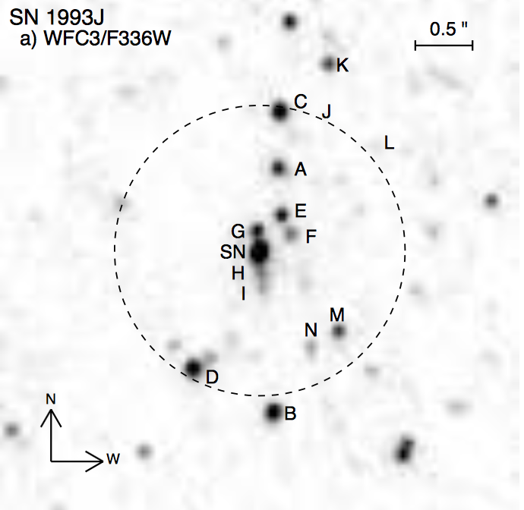
HST/COS Companion Detection
ODF+14a
Notes:
Can increase mass loss rate in lower mass stars.
If a higher mass star loses it’s outer envelope, it might appear more blue and luminous.

Slide 8
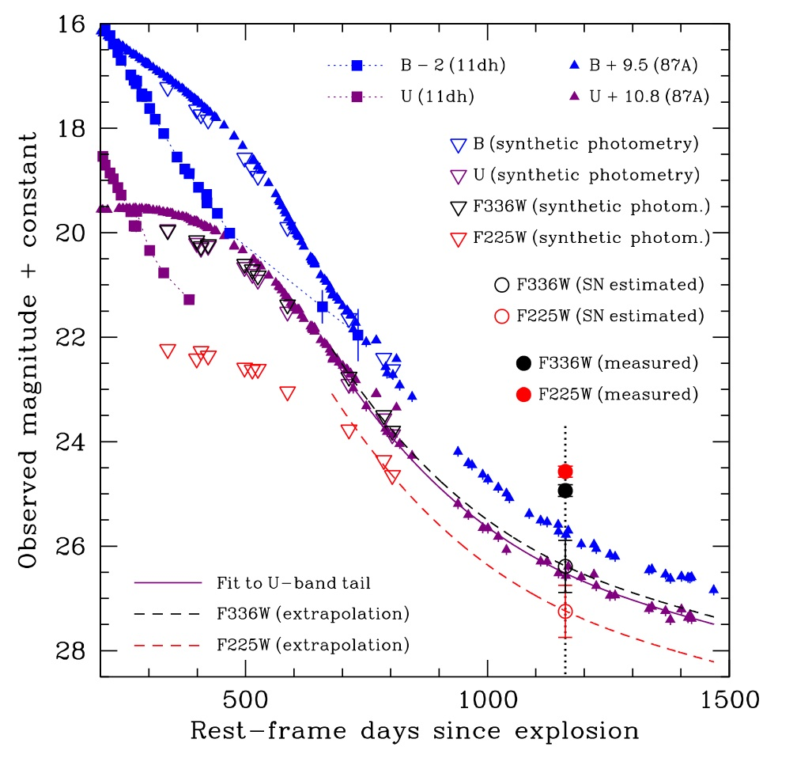
Type IIb SN 2011dh
Folatelli+14
Notes:
Can increase mass loss rate in lower mass stars.
If a higher mass star loses it’s outer envelope, it might appear more blue and luminous.

Slide 9
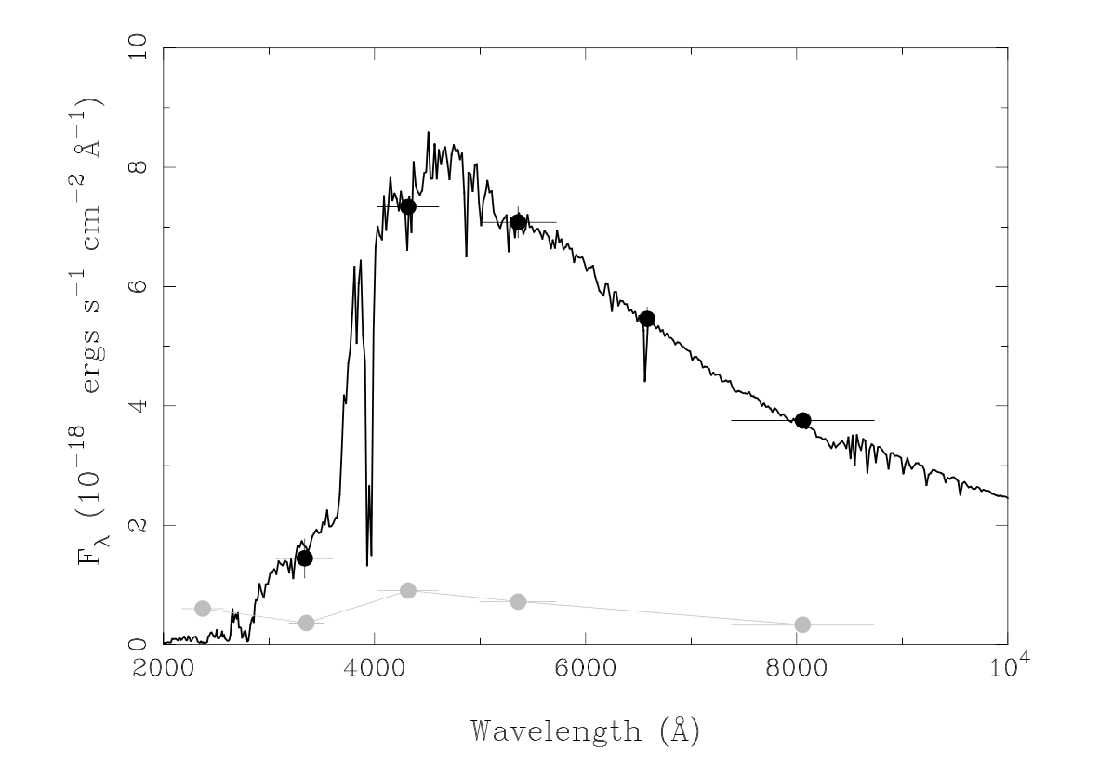
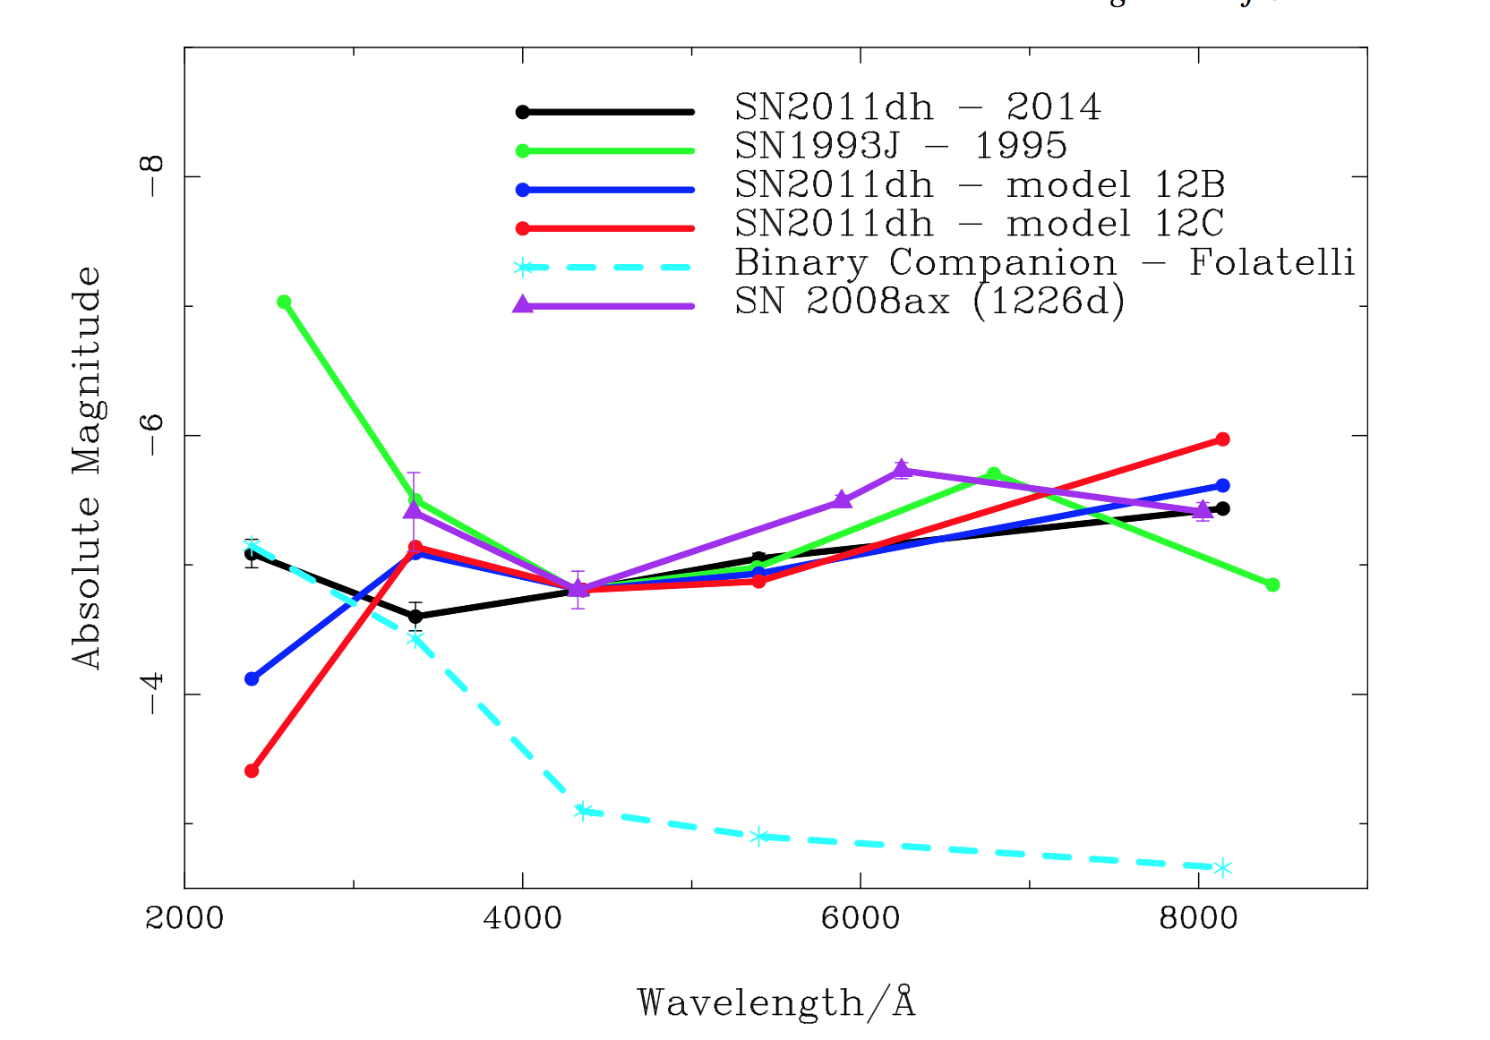
SN 2011dh – Story Continued
Maund+15
Notes:
Left: The observed SED of the pre-explosion (dark points) and late time (light points).
Right: Theoretical and observed late-time SEDs for Type Iib Sne compared to the observed late-time SED of 11dh. The SEDs are normalized to the brightness of the late-time source recovered at the position of the 11dh. Also overlaid are the SED of the binary bompanion proposed by Folatelli et al and observed SED of 08ax at 1226 days.

Slide 10
Population Synthesis
Rapid algorithm based on analytical fits to simulate the evolution both single and binary stars from the ZAMS until they leave behind compact remnants
Predictions for an entire population of massive stars by spanning the extensive parameter space of initial properties
Considers initial conditions: binary fraction, metallicity, winds, tides, angular momentum losses, mergers, and rejuvination.
The fraction and type of binary companions predicted by the simulation depends on the assumed physics.
On the right are some examples of the effect of binary interaction on stellar rotation rates for different initial conditions.
de Mink 2013
Notes:
Rapid algorithms based on analytical fits to the details non-rotating single stellar models to efficiently simulate the evolution of single stars and binary systems from ZAMS until they leave behind compact remannts. This allows us to make predictions for an entire population of massive stars by spanning the extensive parameter space of initial properties that determine their evolution. It also allows us to explore the robustness of our results against variations in our assumptions.
Considers initial conditions, binary fraction, metallicity, normalization, winds, tides, angular momentum losses, mergers and rejuvination.
The fraction and type of binary companions predicted by the simulations depends on the assumed physics.
Four annotated examples of the effect of binary interaction on the stellar rotation rates of main sequence stars for systems with different initial mass ratios and orbital periods. Shows the evolution of the equatorial rotation velocity v_rot of the primary and secondary star as a function of time.

Slide 11
Population Synthesis & Binary Fraction
Population Synthesis: Rapid algorithm based on analytical fits to simulate the evolution both single and binary stars from the ZAMS until they leave behind compact remnants (e.g., de Mink+13).
The binary fraction and type predicted by the simulation depends on the assumed physics and initial conditions.
Sana+12 showed ~75% of all massive stars are in binary systems.
Zapartas+17 show that 30-50% of cases of stripped envelopes that form with binary interaction have no surviving companion.
Therefore, roughly ~35% of stripped envelope SNe should have hot, blue companions. We need a statistically significant sample!
Notes:
binary fraction, metallicity, winds, tides, angular momentum losses, mergers, and rejuvination.
Recall from the Science Justification above that ~70% of all massive stars form in binary systems (Sana+12), and new models suggest that in up to 30-50% of cases with binary interaction there is no surviving companion (Zapartas+17). This statistical combination suggests roughly ~35% of stripped-envelope SNe should have hot, blue companions (assuming single stars can produce some fraction of stripped-envelope SNe). For a sample of nine, the 1 sigma counting statistics yields a value of sqrt(9)=3. Table 2 summarizes the possible outcomes.

Slide 12
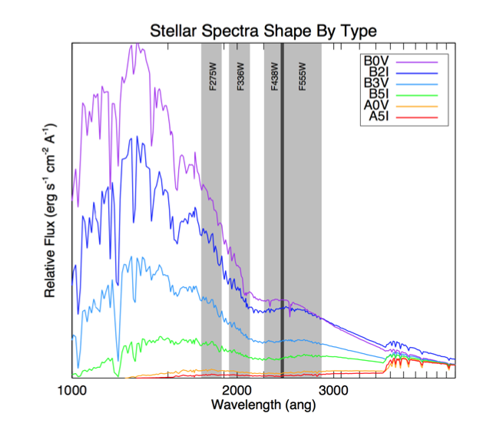
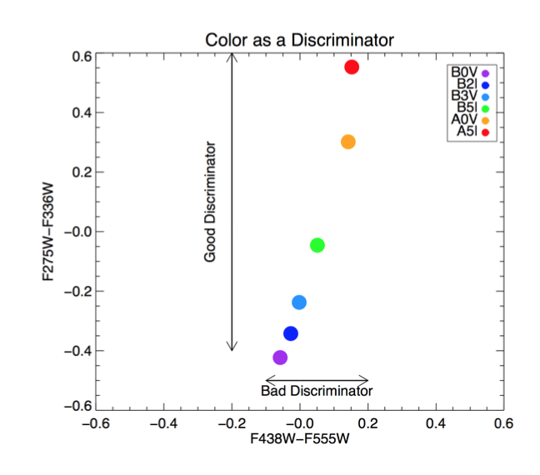
HST Companion Search (GO 14075)

Slide 13
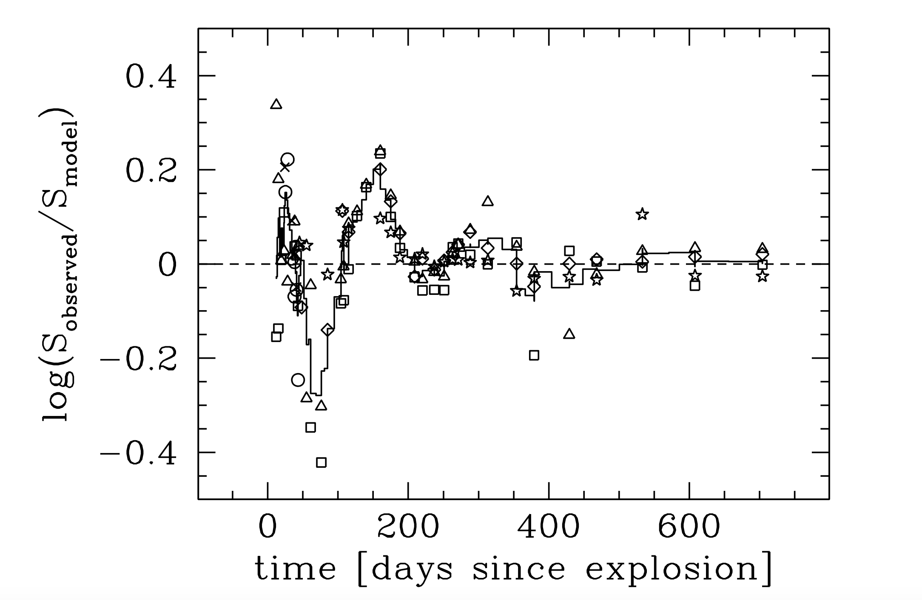
Type IIb SN 2001ig
Weak constraints on distance to NGC 7424
Weak constraints on line-of-sight reddening
Received little optical study despite reaching 12th mag.
Similarities to SN 1993J
No pre-explosion images for direct identifiication.
Ryder+04
Notes:
Weak constraints on distance to NGC 7424 and line-of-sight reddening. Received little optical study despite reaching 12th mag. Similarities to 93J. No pre-explosion images for direct identification.

Slide 14
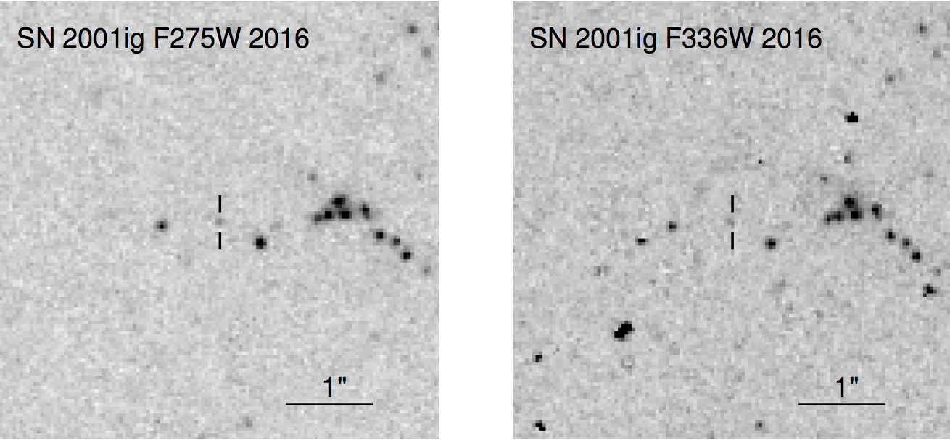
SN 2001ig – Radio Modulations
Ryder+17
Notes:
Weak constraints on distance to NGC 7424 and line-of-sight reddening. Received little optical study despite reaching 12th mag. Similarities to 93J. No pre-explosion images for direct identification.

Slide 15
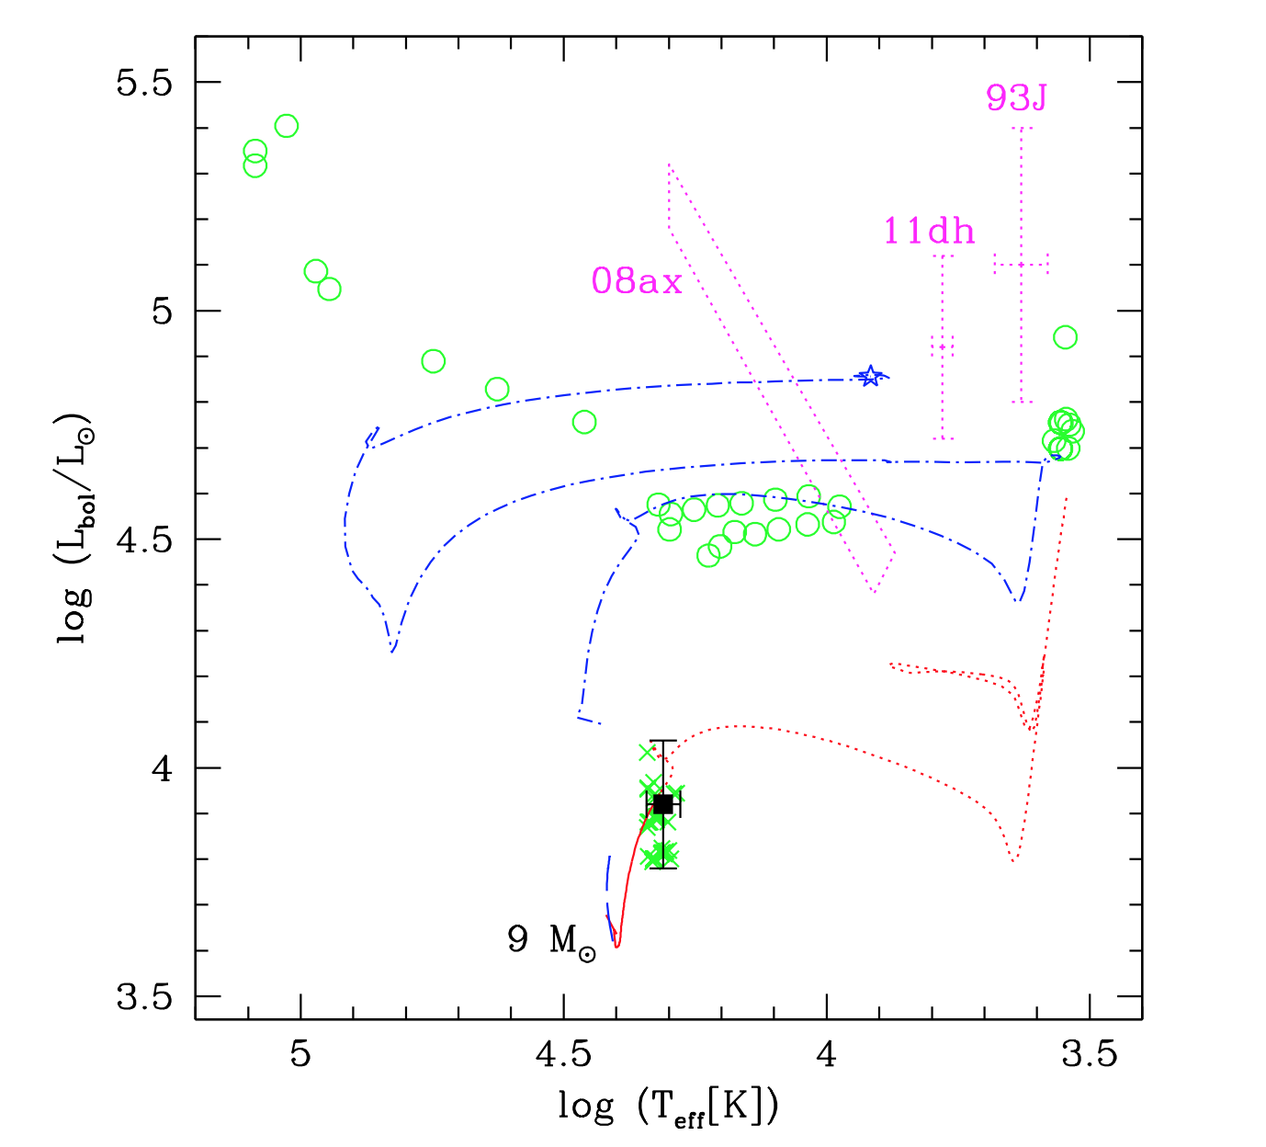
SN 2001ig
Early B-type MS
19000-22000 K
Primary in blue
Secondary in red
42 BPASS models agree with data point.
But in half of these cases, the primary isn’t consistent with other SNe IIb.
Best model has primary 13 M_sol, secondary 9 M_sol, and orbital period of 400 days.
Model also shows a strongly variable mass loss over the last 1700 years due to Roche lobe overflow of the He star primary onto the secondary, which changes the surface conditions and the mass-loss rates. Consistent with Ryder et al. 2004!
Ryder+17
Notes:
Early B-type main sequence star
19000 < T_eff < 22000 K log (L_bol/L_sol) = 3.92
Assumed low reddening, metallicity known
Photometry color consistent w/ early B-type star, with T_eff = 19000-220000 K, corresponding to a V-band brightness of 27.11. Making some assumptions about the distances gives you a bolometric magnitude depending on assumptions you make about whether the star is main sequence. We can then plot a HR diagram. For comparison, we show a MIST single star evolution track at initial mass 9 M_sol at correct metalicity. Solid line up to the data point, then extrapolated with dotted line the rest of the way. Terminal age main sequence.
42 binary evolution modesl generated from BPASS agree with this data point. Also consider green circles, endpoints corresponding to each model’s primary stars. In half of these cases, the primary is cooler (red supergiant) or hotter than expected for SNe IIb progenitors like 11dh and 93J (to which it is most similar) or even 08ax. One model works best: primary with 13 M_sol and secondary has 9 M_sol. And initial orbital period of 400 days.
What’s most interesting is that this model appears to experience a sudden increase in mass loss in the last ~50, 000 yr with strongly variable mass loss over the final ~1700 yr due to late Roche lobe overflow of the He star primary onto the secondary, which changes the surface conditions and thus the assumed stellar wind mass-loss rates. Consistent with the Ryder et al. 2004.
Need continued photometric observations at all wavelengths.
BPASS binary evolution model with primary/secondary 13/9 M_sol.
-> resemble simulataneously HR diagram of observed companion and primary star endpoint for other Sne -> variable late stage mass loss, as expected from the bahavior of the radio light curves
Cleanest detection of a surviving binary companion.

Slide 16
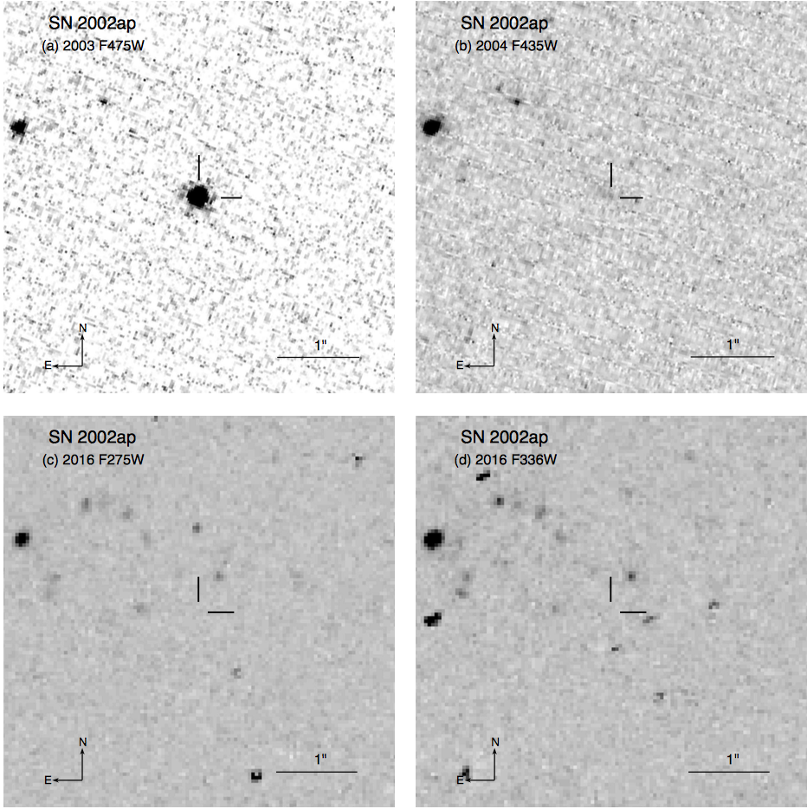
Type Ic-BL SN 2002ap
M74 (~10 Mpc)
No GRB
Ejecta mass of 2.5 M_sol -> Inconsistent with a single, massive progenitor
Host galaxy blue and metal poor
Subsolar metallicity
Upper limits find F275W > 25.8 and F336W > 27.4
Zapartas+17b
Notes:
SN 2002ap in M74, Type Ic-BL (’hypernova’). Central engine? No corresponding GRB detected. Mazzali et al. -> ejecta mass of ~2.5 M_solar and, therefore, a progenitor of ~5 M_solar. Inconsistent with a single, massive progenitor.
Crockett et al. 2007 put limits on the progenitor to M_B > -4.2 and M_R > -5.1, limiting progenitor to < 20 M_solar.
Host galaxy blue and metal poor, consistent with findings of Kelly and Kirshner (2012). HST observations not currently deep enough to constrain local star formation. Modjaz made a metallicity estimate => Subsolar.
This work finds upper limits of 25.8 and 27.4 in F275W and F336W, respectively.

Slide 17
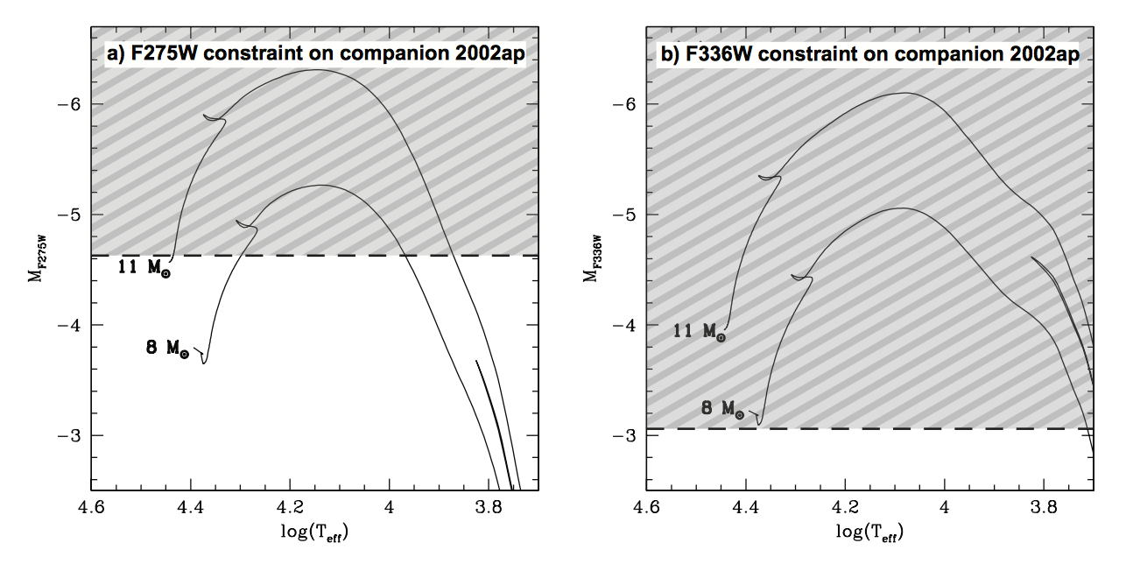
SN 2002ap
Zapartas+17b
Notes:
Need to convert magnitudes into a luminosity.
Assume the distance to M74 is 10.19 Mpc from the TRGB (Jang & Lee 2014). Little reddening from studies of 02ap nebular spectra.
We also assume that the star must lie relatively close the ZAMS.
F336 observations constrain companion down to <8 M_sol. Crockett previously ruled out initial mass down to <20 M_sol.

Slide 18
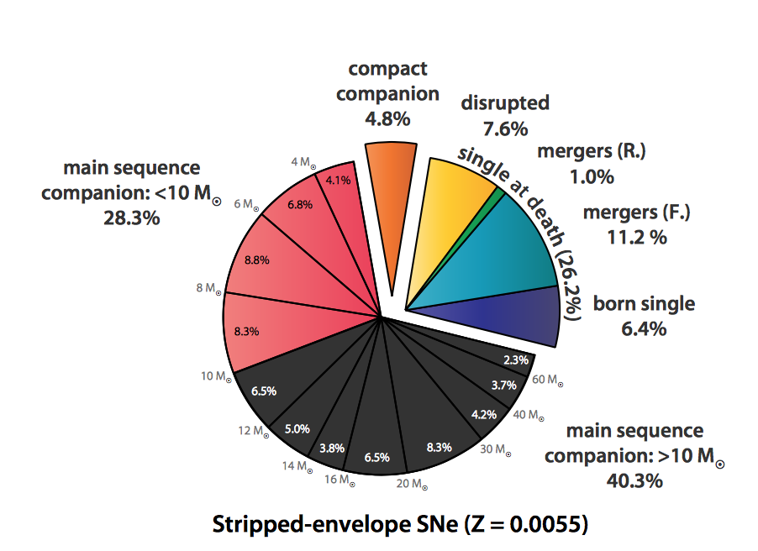
SN 2002ap - Pop Syn
Zapartas+17b
Notes:
Expected progenitors for this metallicity scenario.
For a subsolar metallicity consistent with 02ap, we expect a MS companion present in about 2/3 of all stripped-envelope SNe, and a compact companion in only 5% of cases. About 25% are single at time of explosion (single stars/mergers/disrupted systems), requiring a massive progenitor.
Our new upper limits rule out the presence of a main sequence companion > 8-10 M_solar, ruling out about 40% of all stripped envelope channels.
You have both conservative and non-conservative mass transfer, which corresponds to the distance separation.
****** Case A/B refers to semiconservative mass transfer with small orbits. Secondary gains significant mass and evolves on its own evolutionary timescale. Case C is nonconservative mass transfer, often ending in a common envelope.
Most likely scenario is nonconservative binary interaction of a primary star < 23 M_sol. Although unlikely (<1 %), there is also the possibilitity of an exotic reverse merger.
Ejecta masses tend to be 2-5 M_solar, suggesting low progenitor masses.
Furthermore, about a third of all core-collapse Sne are thought to have stripped progenitors. Single star models fail to explain the high relative rates of stripped-envelope Sne and a binary channel is required to explain the discrepancy.

Slide 19
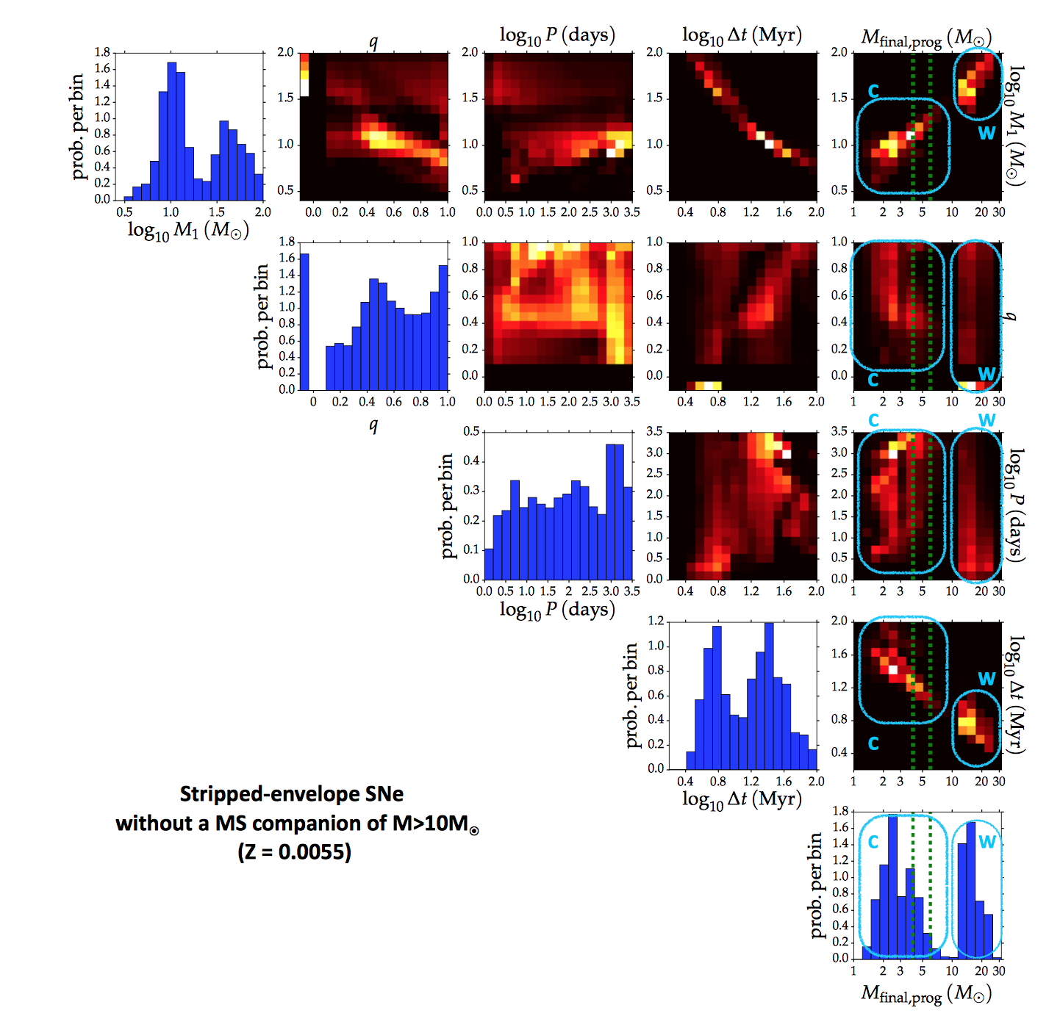
02ap Progenitor Constraints
Higher-mass end of Group C (Companion) Binary interaction mass loss Initial mass 13-23 Msolar
q < 0.6
Period > 1000 days
Non-conservative mass transfer
Zapartas+17b
Notes:
Allowed progenitor population actually bimodal! First 3 panels display the initial parameters that characterize the progenitor system. Initial mass, mass ratio, orbital period, progenitor lifetime, and final pre-explosion mass of progenitor.
The large mass progenitors can be characterized by strong stellar winds (W). Mostly single stars and binaries with massive companions. No companions are expected at the moment of explosion. The lower mass progenitors can be characterized by companion mass transfer (C). Group C is 1.6x more probably than Group W.
Aha. But we have an additional constraint! From the light curve, Mazzali et al. (2002) estimate the ejecta mass to be about 2.5 M_sol, which is consistent with a final progenitor mass of about 5 M_sol. These uncertainties are highlighted by the green dotted lines. Only about 6% of all striped-envelope Sne have final progenitor masses in this range.
This additional constraint provided by the progenitor final mass limits the 02ap progenitor to the higher-mass end of Group C, having lost its envelope through binary interactions. Initial primary mass between 13-23 M_sol, q<0.0.6, and period > 1000 days. Non-conservative mass transfer, possibly involving a CE phase. Conservative mass transfer unlikely as they would result in massive companions.
A further minority channel for the progenitor of 02ap concerns reverse mergers, in which the secondary engulfs the stripped remnant of the primary, which can be a helium burning compact star or white dwarf. Their contribution is not significant according to our simulations (~1%). However, they are of potential interest as they provide a way to produce the rapidly rotating systems that are probably required for SNe Ic-BL.
Questions unanswered by this method: How helium layers are removed? How do you get the BL part of the event? But the rare merger event (<1% of cases) could explain the high angular momentum. The merged star will have already completed its central hydrogen-burning phase and possibly even contain a helium-exhausted core. In such a scenario, the remaining lifetime of these merged stars will be short.
*******
A small (<10%) chance of the progenitor being an explosion of the secondary star, originating from binary systems of almost equal mass. Leaving a compact companion (primary) at the moment of explosion, either a WD, NS, or BH, or even stripped He star.

Slide 20
Conclusions
Binary fraction and type has implications on the underlying physics of star formation and stellar evolution.
We are building up a sample of search for binary systems, but to date only have a handful. SN 2001ig provides one of the cleanest detections yet. SN 2002ap provides a useful upper limit that suggests the presence of a companion.
GW170817 progenitor was likely old (10^9 years) consistent with MW ages of neutron star systems.

