Slide 1
Interpreting the Spectra of Tidal Disruption Events
Image credit:
Jane Dai
Nathaniel Roth
UMD and NASA GSFC
Collaborators: Daniel Kasen (UC Berkeley), James Guillochon (Harvard), Enrico Ramirez-Ruiz (UCSC and NBI), Brad Cenko (NASA GSFC), Suvi Gezari (UMCP), Jane Dai (NBI), …

Slide 2
The puzzling optical/UV emission
SDSS TDE1 and TDE2
PS1-10jh
Van-Velzen+ 2011
Gezari+ 2012

Slide 3
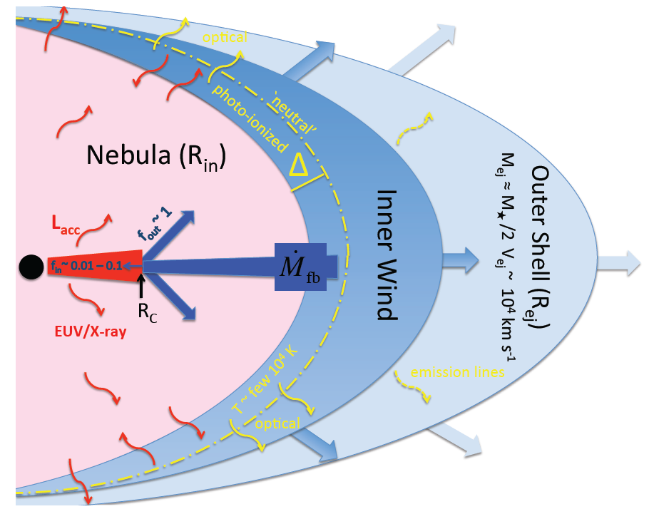
Not as simple as we hoped…
We want to learn about the black hole
Measure its mass
Probe super-Eddington accretion
But what exactly are we seeing?
Thick accretion disk?
Stream collisions?
Outflow?
McKinney+ 2014
Jiang+ 2016
Metzger & Stone 2016
Notes:
So there’s been a lot of these events found in recent years. But now we have to step back and think about what this all means…
There’s been excitement about what we might be able to learn from TDEs, especially about the black holes involved
This is one way to see a signal from a massive black hole when it had previously been quiet and hiddenn. And then maybe we can use that signal to learn things like the mass of the hole: maybe we can fill out the M– sigma relation at its lower mass end, where it is least well-constrained.
But first, we have to know what exactly we are seeing. Where is the emission coming from? Are seeing a thick accretion disk, maybe with gas that reprocesses its emission further out? Are we seeing emission from shock heating at debris stream intersections? Is there a jet, either pointed toward us, or maybe off axis?

Slide 4
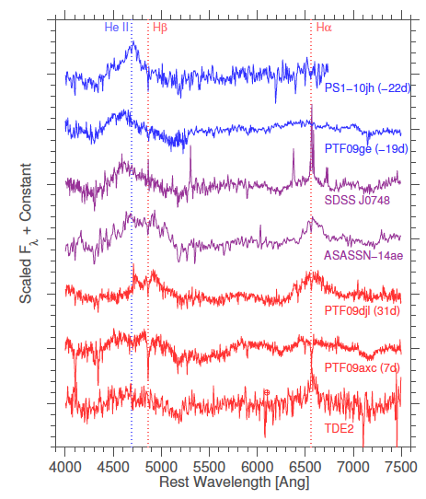
Spectra hold the answers!
Arcavi+ 2014

Slide 5
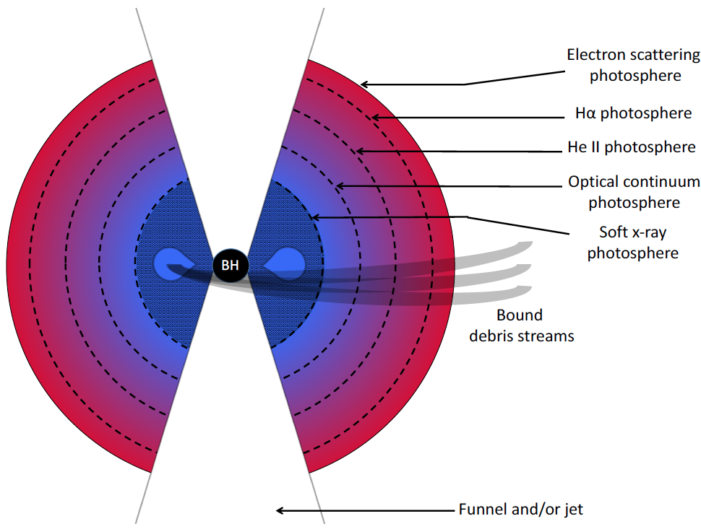
Radiative transfer calculation analogous to stellar atmosphere
Roth+ 2016

Slide 6
A range of line ratios, all with solar H and He abundance ratio
Roth+ 2016

Slide 7
H⍺ Line profiles from ASASSN-14li and ASASSN-14ae
Holoien+ 2016

Slide 8
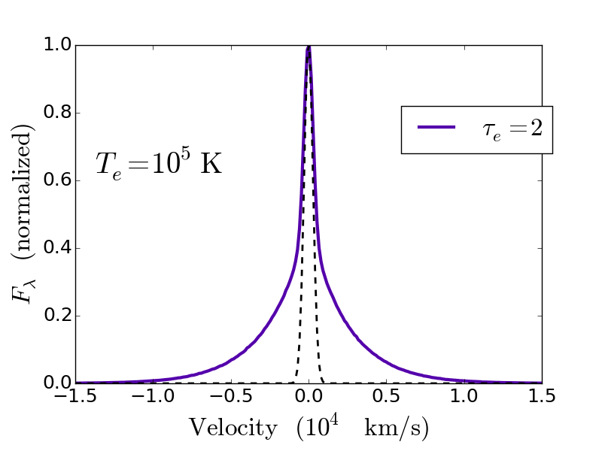
Broadening by non-coherent scattering

Slide 9
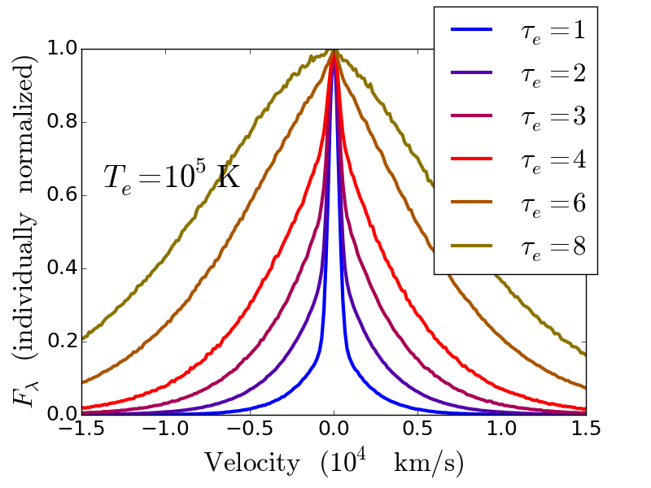
Varying optical depth
Roth & Kasen 2017

Slide 10
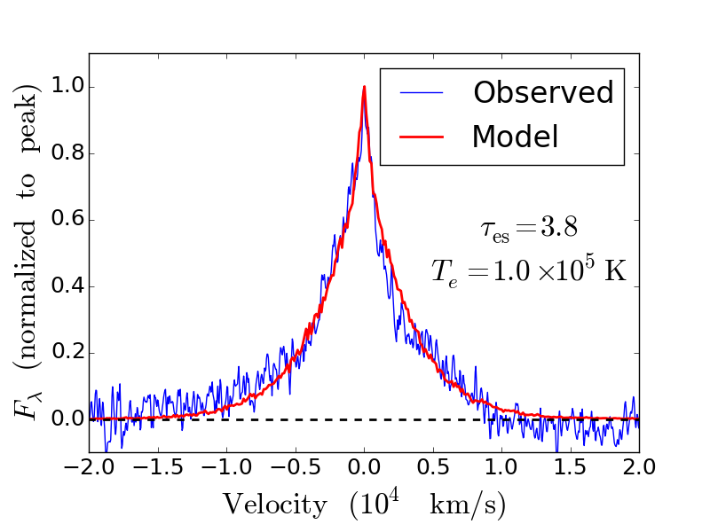
Fits to ASASSN-14li line profiles
Day 9
Roth & Kasen 2017

Slide 11
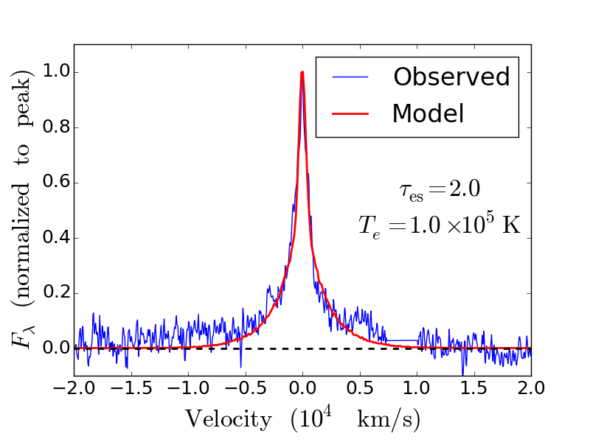
Fits to ASASSN-14li line profiles
Day 85
Roth & Kasen 2017

Slide 12
What about an outflow/wind?
Roth & Kasen 2017

Slide 13
Blue-shifted peak, extended red wing
ASASSN-14ae
Holoien+ 2014

Slide 14
Blue-shifted peak, extended red wing
Arcavi+ 2014

Slide 15
Blue-shifted peak, extended red wing
ASASSN-15oi
Holoien+ 2016

Slide 16
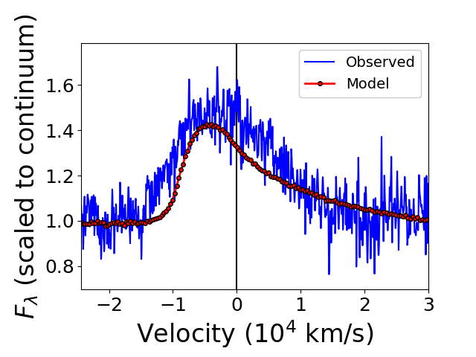
Fit to ASASSN-14ae line profile
Roth & Kasen 2017

Slide 17
Adiabatic reprocessing in outflow
Roth & Kasen 2017

Slide 18
Simulations of Super-Eddington Accretion in TDEs with fast outflows
Jane Dai et al

Slide 19
Fast outflows lead to very broad SEDs
Jane Dai et al

Slide 20
Conclusions
Spectra hold the key to understanding the optical emission from TDEs
Non-coherent scattering can provide a major component of the line widths
In some cases can dominate over kinematic broadening
May explain the narrowing of lines over time.
Emission lines with blue-shifted centroids may be outflow signatures
For hydrogen and helium, we don’t expect P-Cygni profiles
The corresponding red-skewed asymmetry makes sense in the context of trapping the line emission in expanding gas
As the outflowing gas expands, we expect the line to become more centered and symmetric, as borne out in the observations (e.g. ASASSN-14ae).
Fast outflows with trapped radiation lead to very broad SEDs
In addition to generation of optical continuum radiation, can allow for simultaneous x-ray and optical detections

Slide 21
Extras

Slide 22
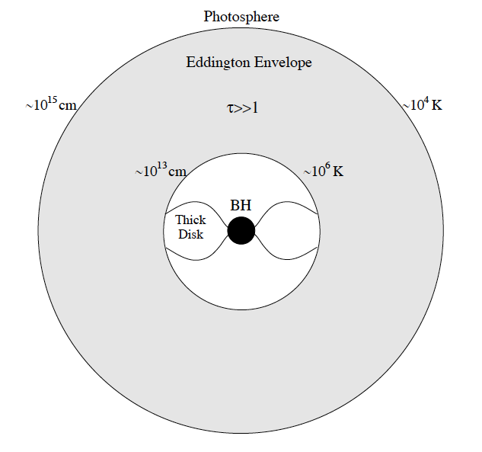
What produces the optical emission? Reprocessing?
Loeb & Ulmer 1997

Slide 23
What produces the optical emission?
Puffy accretion disk?
McKinney+ 2014

Slide 24
What produces the optical emission? Outflow?
Metzger & Stone 2015

Slide 25
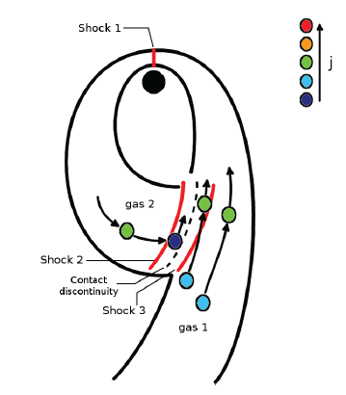
What produces the optical emission? Shocks from stream collisions?
Shiokawa+ 2015
Bonnerot+ 2016

Slide 26
What produces the optical emission? Outflows from collision?
Jiang+ 2016

Slide 27
No evidence of P-Cygni profiles in ASASSN-14li
Cenko+ 2016

Slide 28
Tentative evidence for P-Cygni profile in UV spectrum of iPTF-16fnl
Brown+ 2017

Slide 29
Raising the line excitation temperature
Roth & Kasen 2017

Slide 30
An analogue: Shock-powered nova outburst
Li+ 2017

Slide 31
Re-centering of the line
Roth & Kasen 2017

Slide 32
Advection, diffusion, expansion

Slide 33
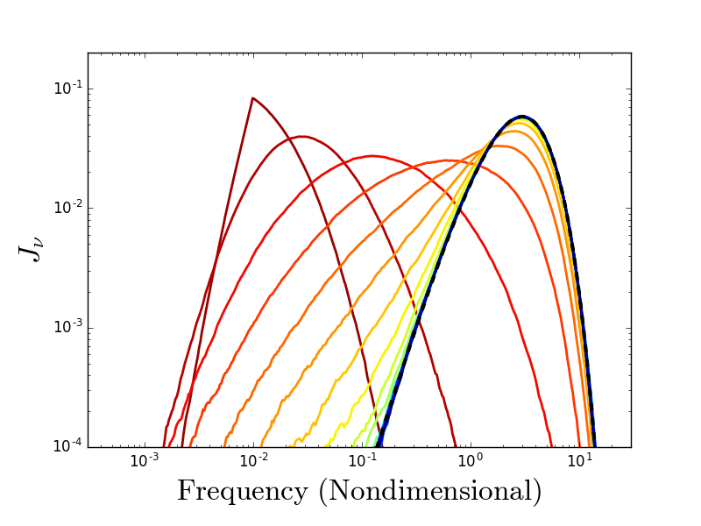
Comptonization
Input: Delta function in frequency
Evolves to Wien spectrum
Notes:
Spectral energy as a function of frequency.
Test problem where we start with radiation all at a single, low frequency and let it scatter repeatedly off a bath of hot electrons. As the photons scatter multiple times, they pick

Slide 34
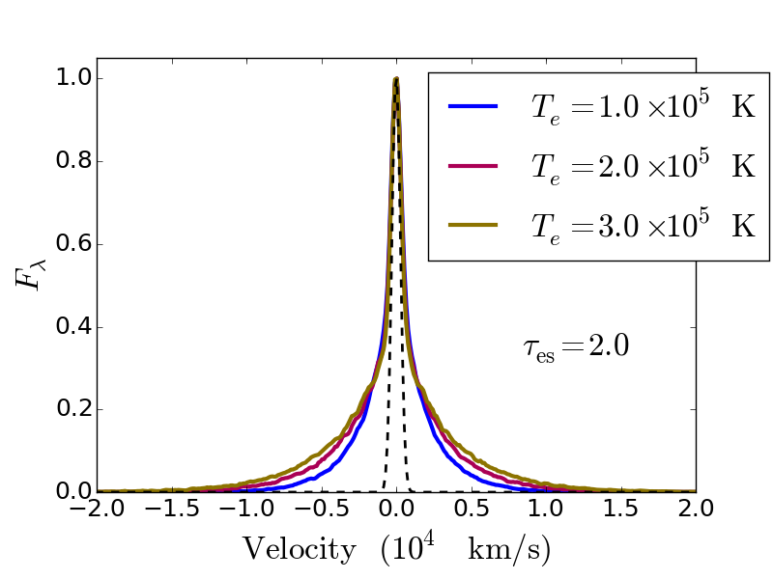
Varying electron temperature

Slide 35
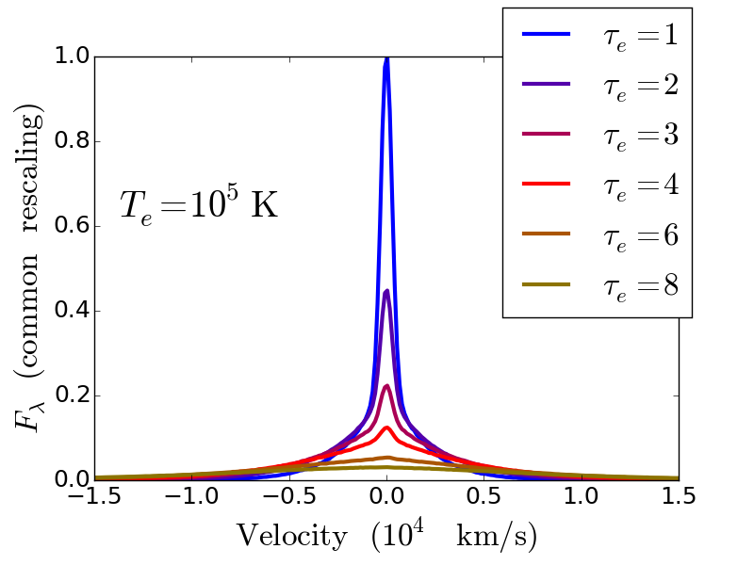
Washing out the line
Notes:
I’d like to point out here that something else that’s happening, in addition

Slide 36
Broad absorption troughs
Chornock et al 2014
Notes:
So there’s the UV absorption trough. And there might be a hint of an emisison wing
So now we have to think about how the simple model I explained needs to be modified.
This coincides with what you might expect - as the atmosphere becomes denser, you no longer see the red emission side, and just the blue absorption.

Slide 37
Blue-shifted peak, extended red wing
Arcavi+ 2014

Slide 38
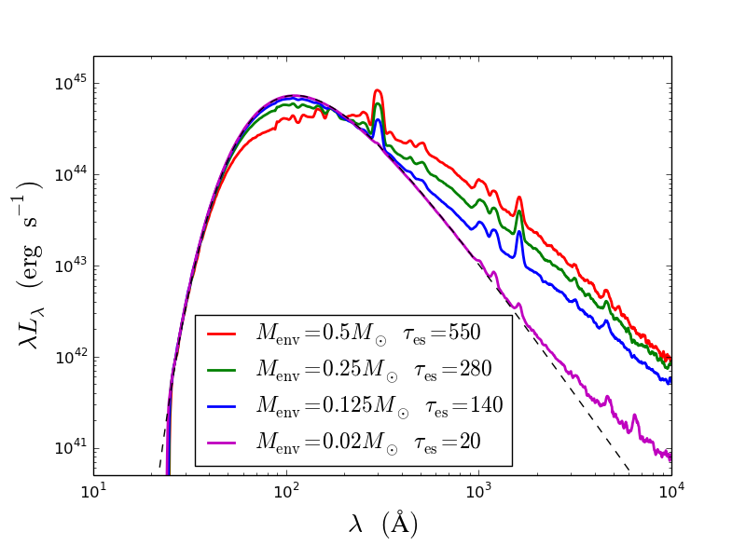
SEDs : Varying mass in envelope
Parameter values:
10⁴⁵ erg s⁻¹ bolometric luminosity
Inner radius 10¹⁴ cm
Outer radius 5 x 10¹⁴ cm
Roth et al 2016

