Slide 1
Cocoons, structured jets, binary neutron star mergers, and GW170817
Davide Lazzati (Oregon State University)
Rosalba Perna (Stony Brook)
Brian J. Morsony (UMD)
Diego López-Cámara (UNAM)
Matteo Cantiello (CCA – Princeton)
Riccardo Ciolfi (Padua)
Bruno Giacomazzo (Trento)
Jared C. Workman (Colorado Mesa)

Slide 2
Cocoon: what is it?
Notes:
Spell out SN

Slide 3
Ron Howard et al. (1985)
Begelman & Cioffi 1989
Matzner 2003
DL & Begelman 2005
Bromberg et al. 2011

Slide 4
The question:
Does
GW170817/GRB170817A represent a new class of transients or is it just a regular short GRB seen off-axis?
Notes:
Spell out SN

Slide 5
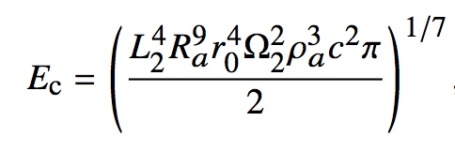
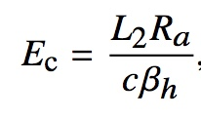
Analytic cocoons
DL + 2017a
Notes:
Spell out SN

Slide 6
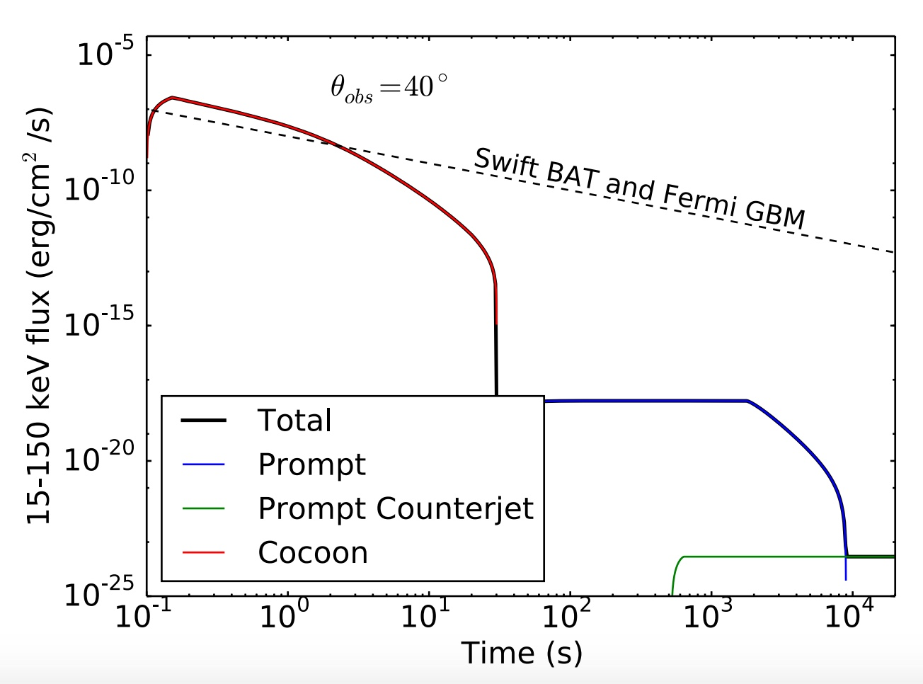
Analytic cocoons
DL + 2017a

Slide 7
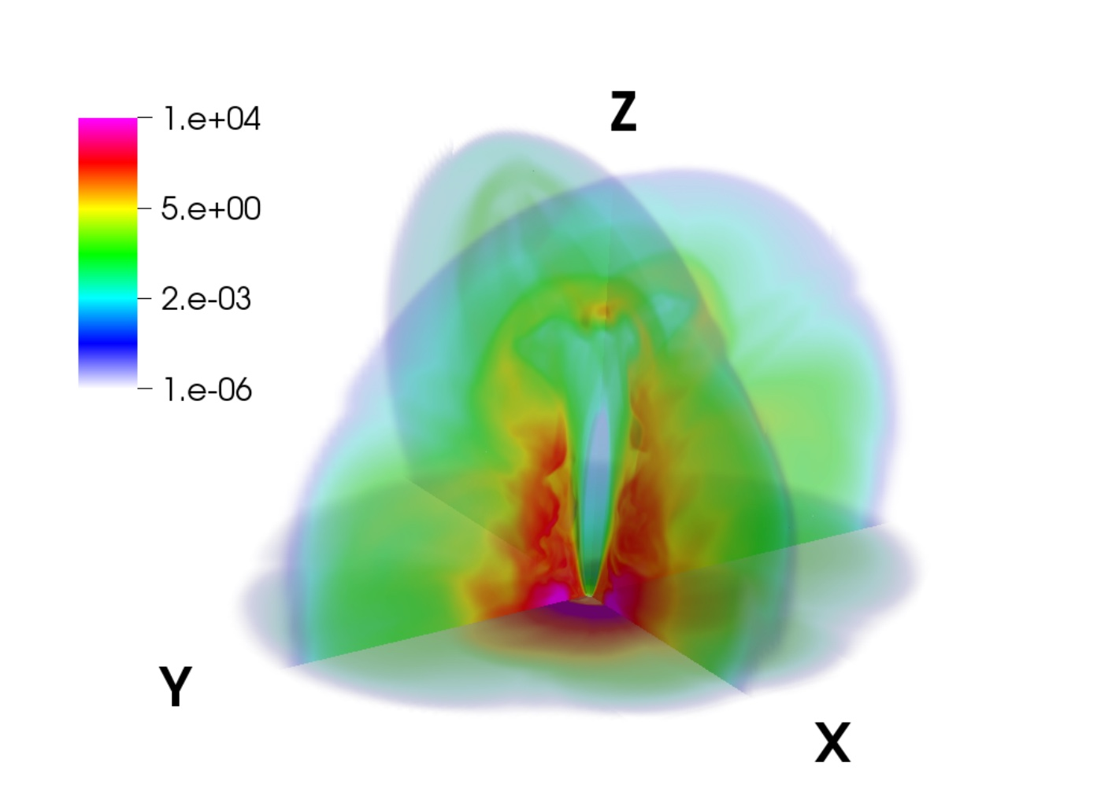
Numerical cocoons
DL + 2017b

Slide 8
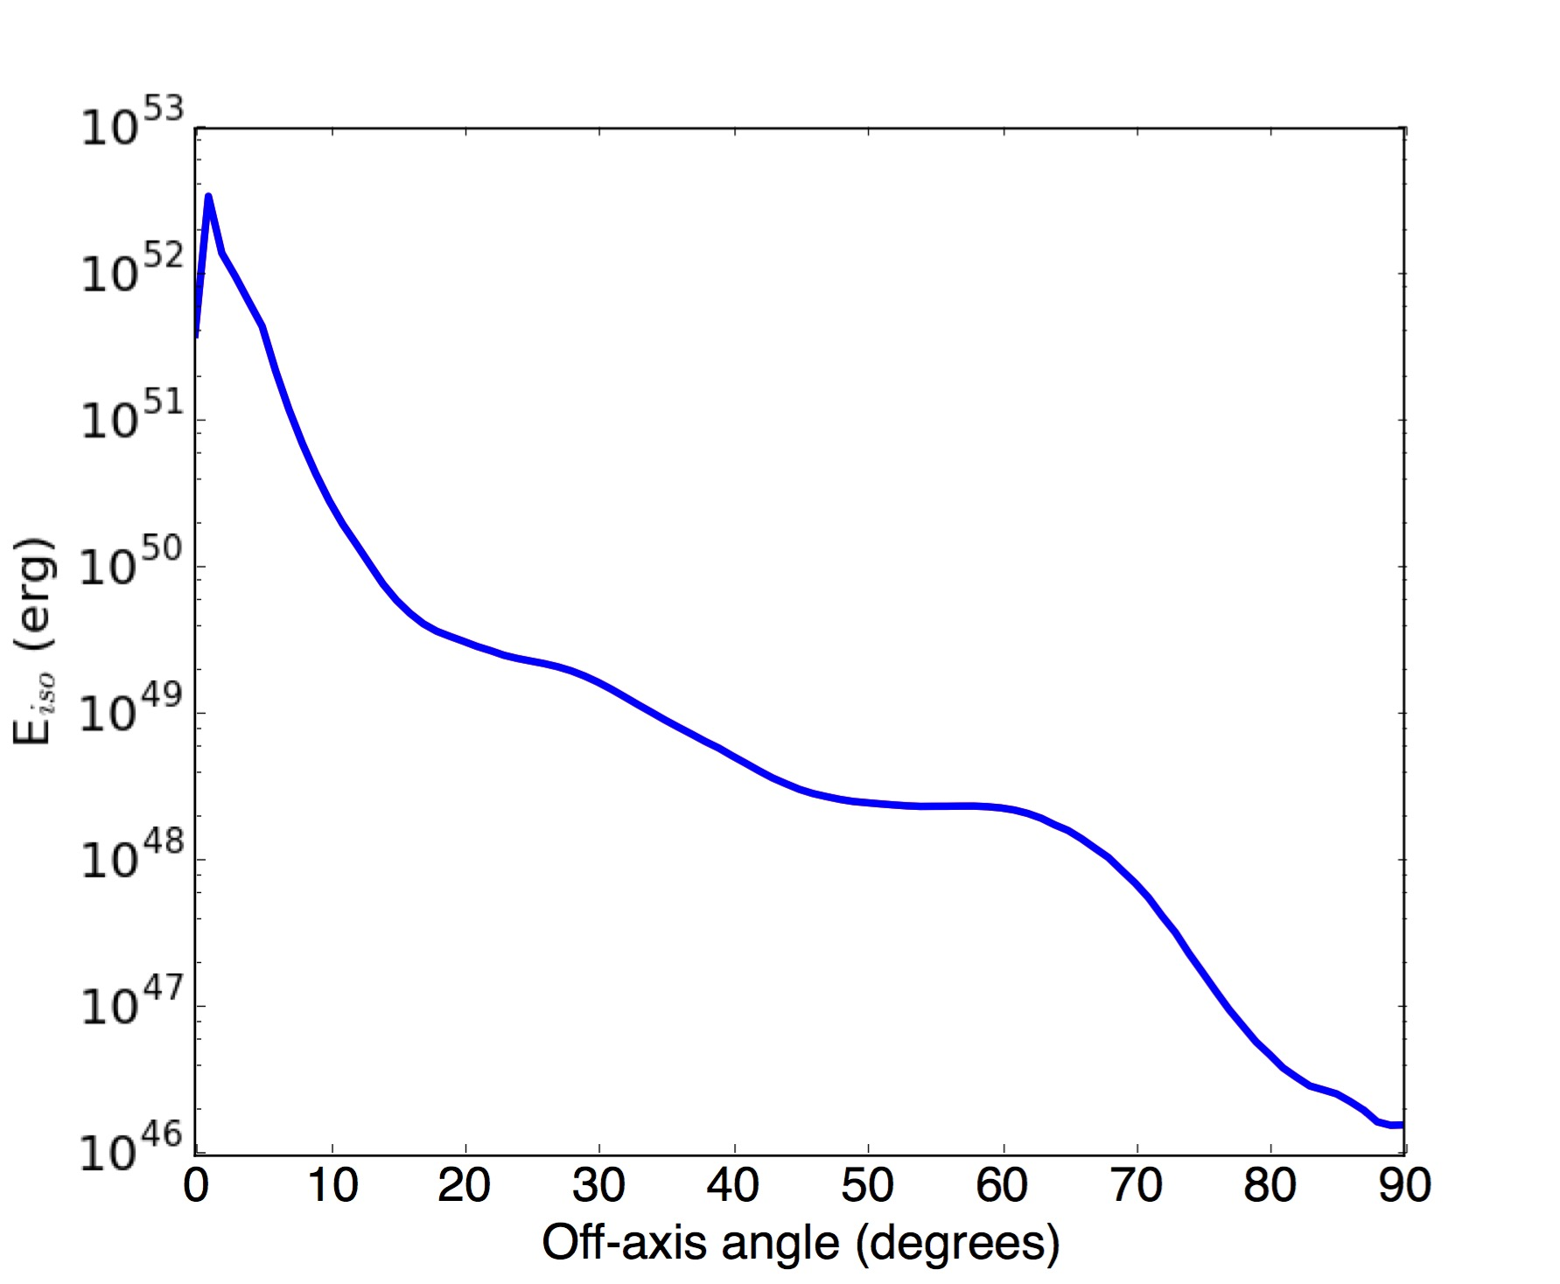
Numerical cocoons
Not really a jey+cocoon anymore.
More like a structured jet
DL + 2017b

Slide 9
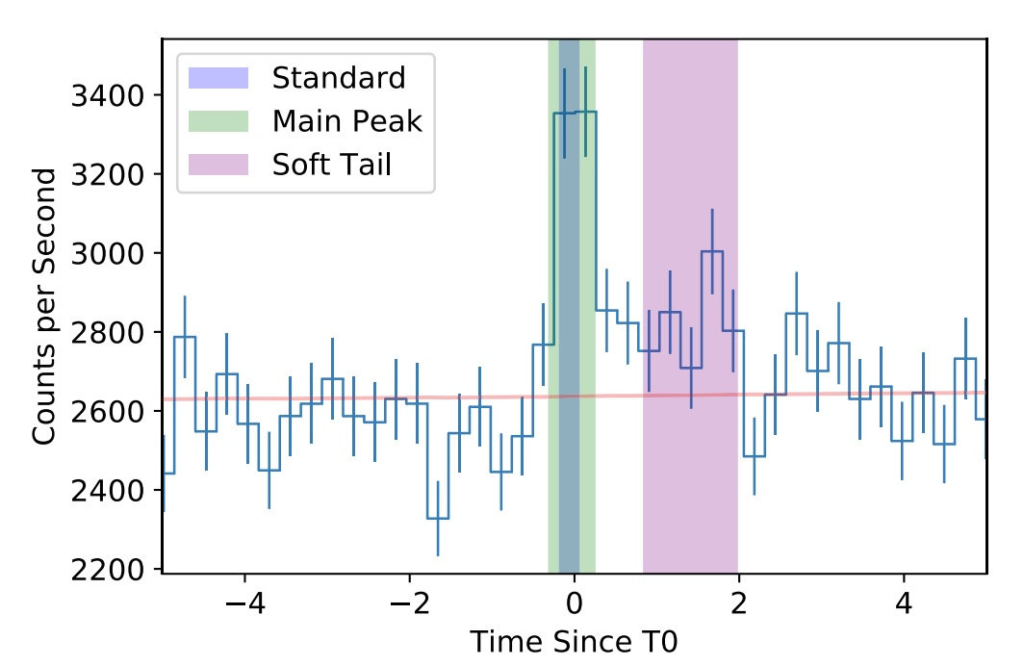
GRB170817A
Abbott et al. 2017
Goldstein et al. 2017
Delay: ~2s
Duration: ~2s
Fluence: ~2x10⁻⁷ erg cm⁻² s⁻¹
Distance: ~40 Mpc
Iso Energy: ~10⁴⁷ erg
νF(ν) peak: ~200 keV
θ_{obs}<30º

Slide 10
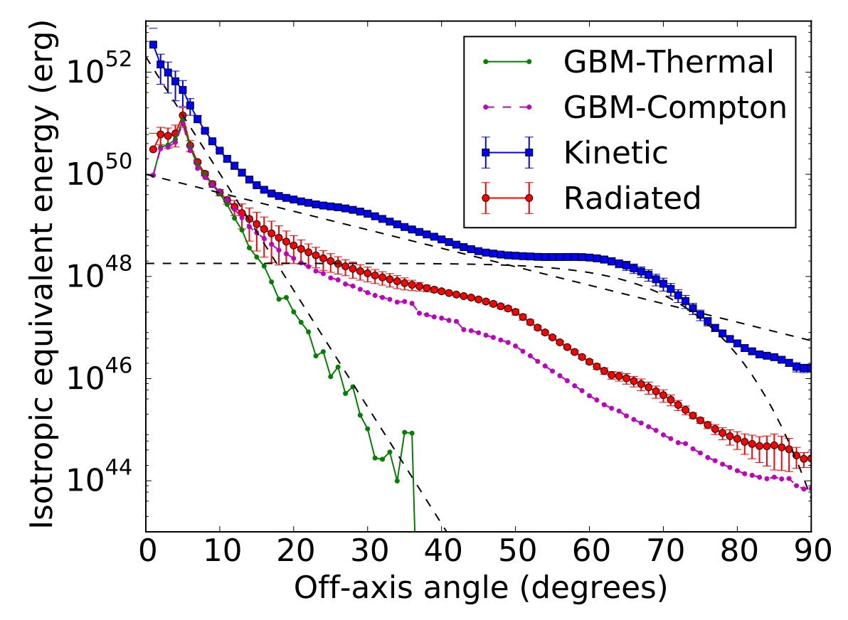
Numerical Cocoons: prompt emission
DL + 2017b

Slide 11
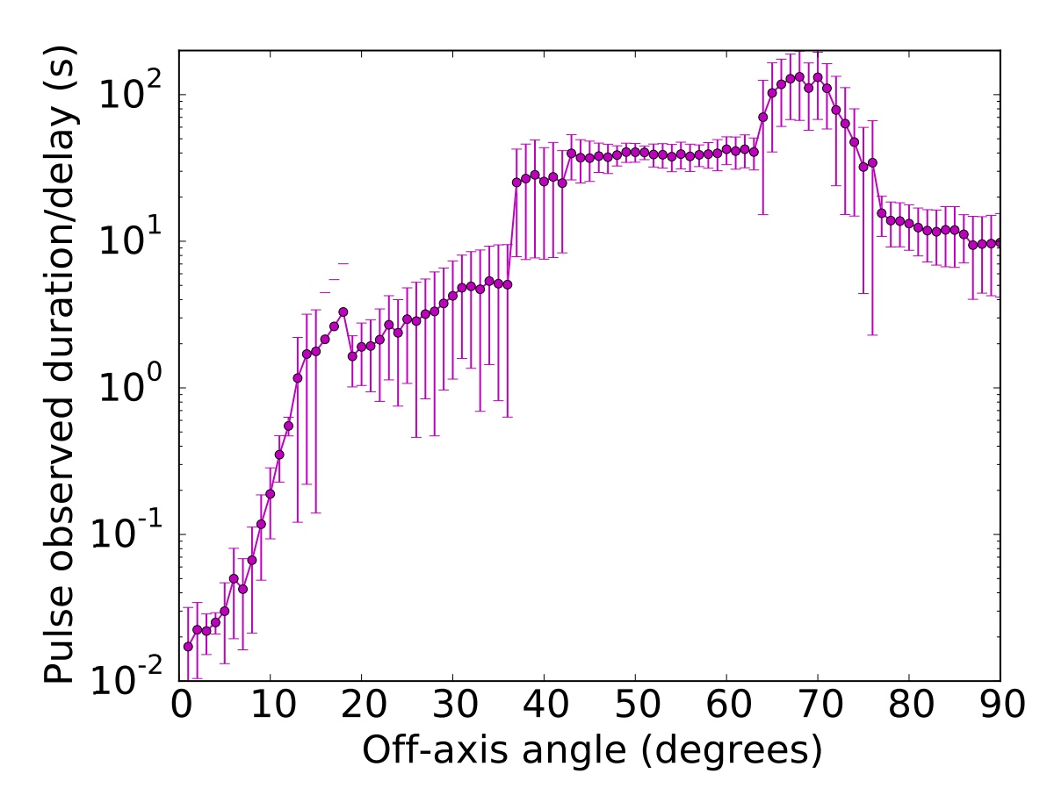
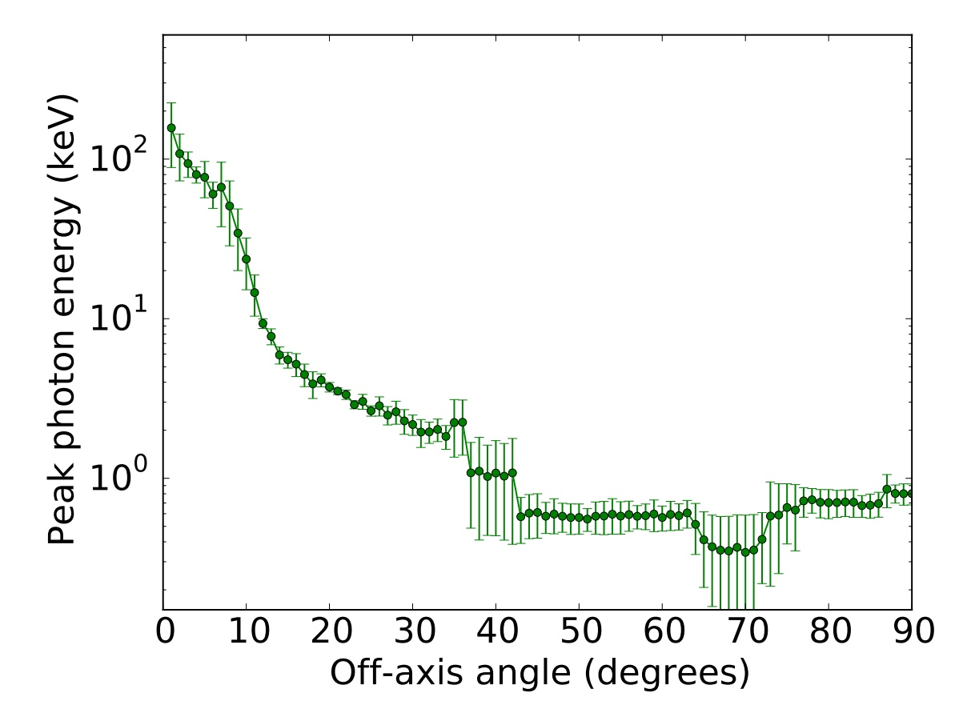
Numerical Cocoons: prompt emission
DL + 2017b

Slide 12
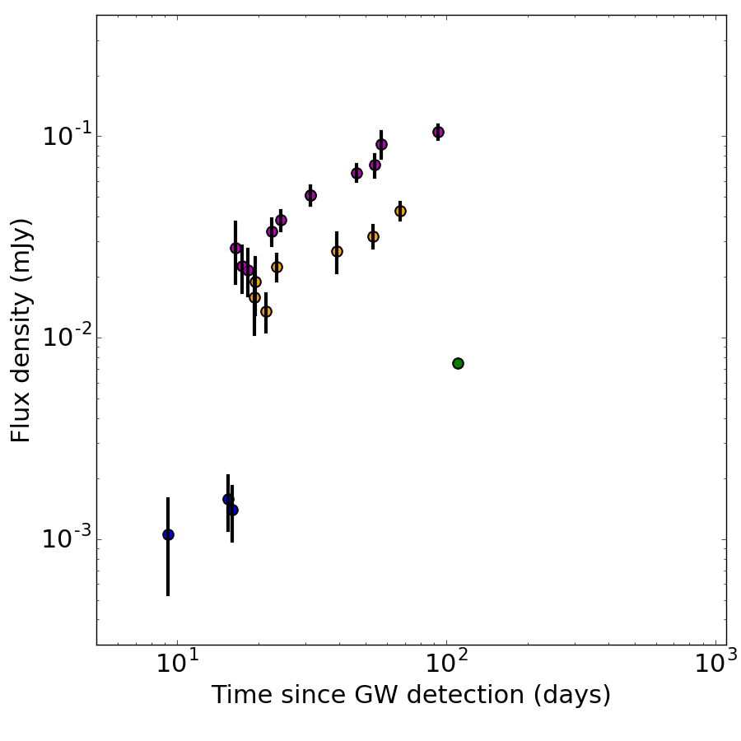
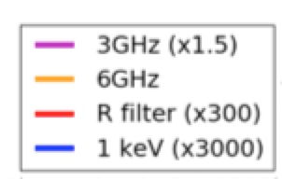
Afterglow Data
Alexander et al. 2017
Hallinan et al. 2017
Mooley et al. 2017
Troja et al. 2017;
Margutti et al. 2017

Slide 13
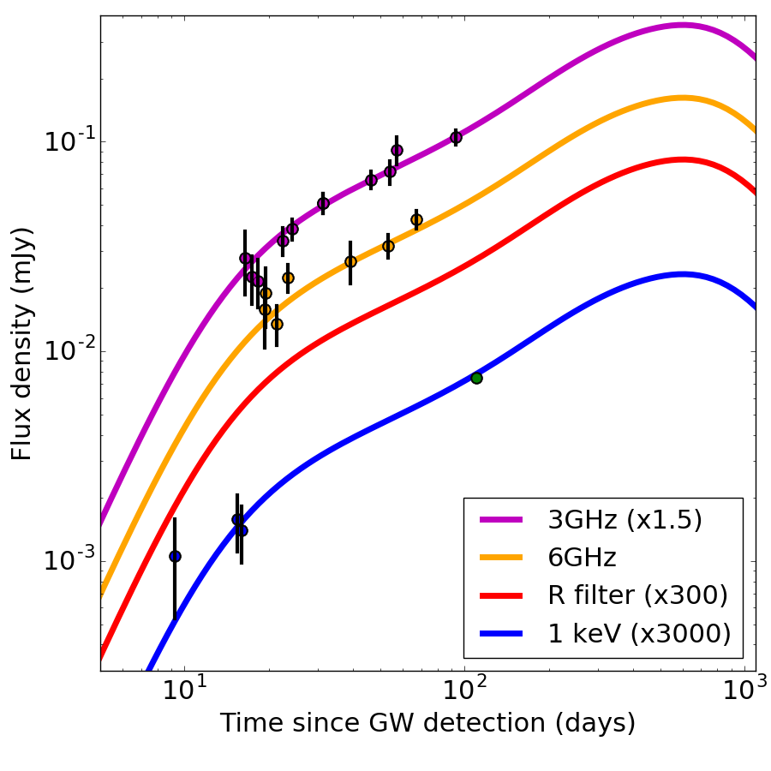
Afterglow Data & Models
Alexander et al. 2017
Hallinan et al. 2017
Mooley et al. 2017
Troja et al. 2017;
Margutti et al. 2017
ISM density
Electrons energy
Electrons distribution
B field
Viewing angle
DL + 2017c

Slide 14
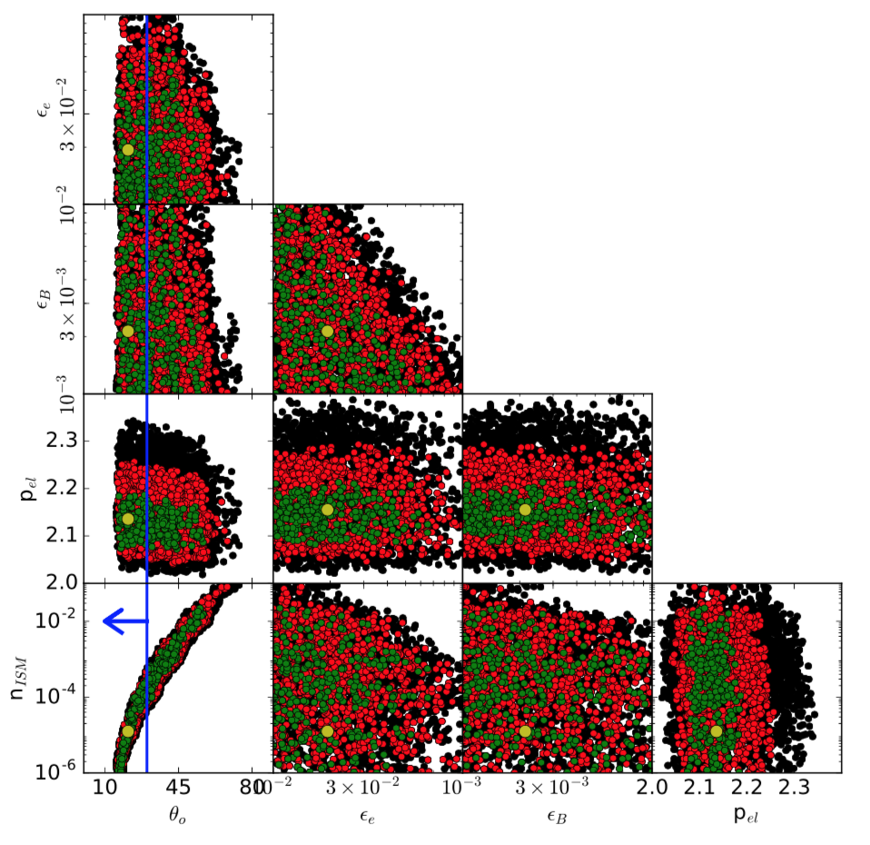
Afterglow Data & Models
ISM density
Electrons energy
Electrons distribution
B field
Viewing angle
DL + 2017c

Slide 15
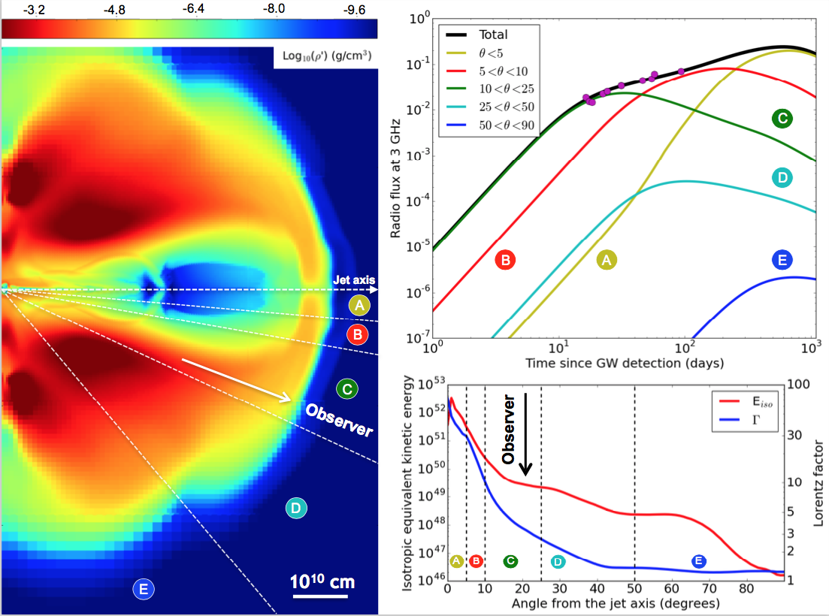

Slide 16
Conclusions/Discussion
θ_{o} from GWs
θ_{o} from γ-ray pulse energy
θ_{o} from γ-ray pulse delay-duration
θ_{o} from blue kilonova
θ_{o} from afterglow model
And then there’s the spectrum…

Slide 17
Conclusions/Discussion
We do NOT have direct evidence of an off-axis jet
But the circumstantial evidence is convincing
Nothing in this model is fine-tuned
About one in 20 LIGO/Virgo detected NS-NS mergers have on-axis SGRB
Afterglow models are available at science.oregonstate.edu/~lazzati/cocoon.html

